Slide 1


Jonathon Wright
Where I work:
Department of Earth System Science
Tsinghua University, Beijing, China
My research:
Coupled water & energy cycles
Monsoon dynamics
Atmosphere-ocean interactions
Stratosphere-troposphere interactions & exchange
Water isotopes
jswright@tsinghua.edu.cn
jonathonwright.github.io

Slide 2
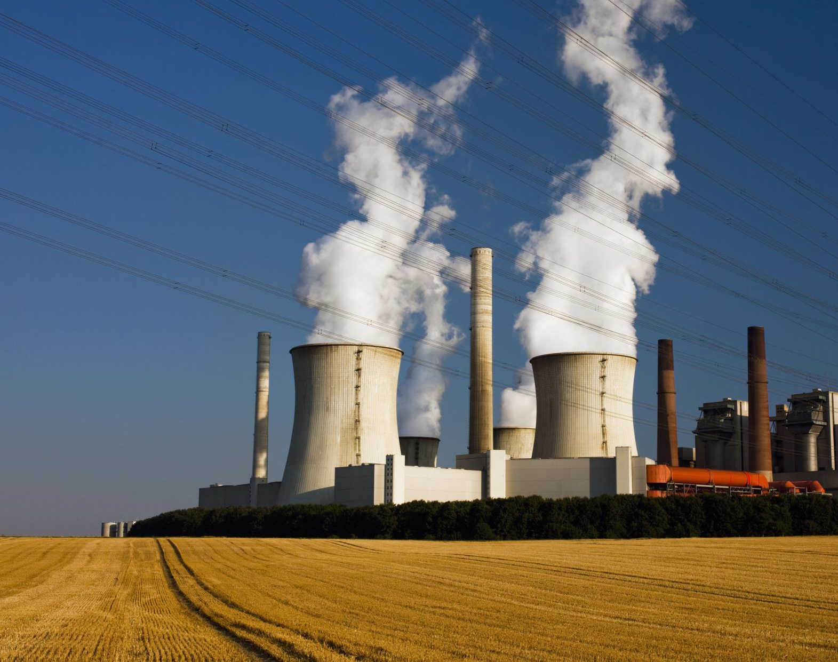





TWO KINDS OF 'HEAT'
MOISTURE
WATER STORES ENERGY THE ‘CENTRAL BANK’ OF THE EARTH SYSTEM
WATER CONVERTS ENERGY PHASE CHANGES
WATER MOVES ENERGY FLUID SUNSHINE
WATER TRAPS ENERGY GREENHOUSE & ALBEDO EFFECTS
ATMOSPHERE-OCEAN COUPLING
TEMPERATURE
HEAT AND MOISTURE BUDGETS
CLOUDS, AEROSOLS, & RADIATION

Slide 3



What’s Doing the Work?
Dynamics
Physics
Stratosphere–troposphere exchange
Conversion and Heating
radiation
?
aerosol
clouds
Sources and Transport
Atmosphere–ocean interactions

Slide 4

For example...

Slide 5

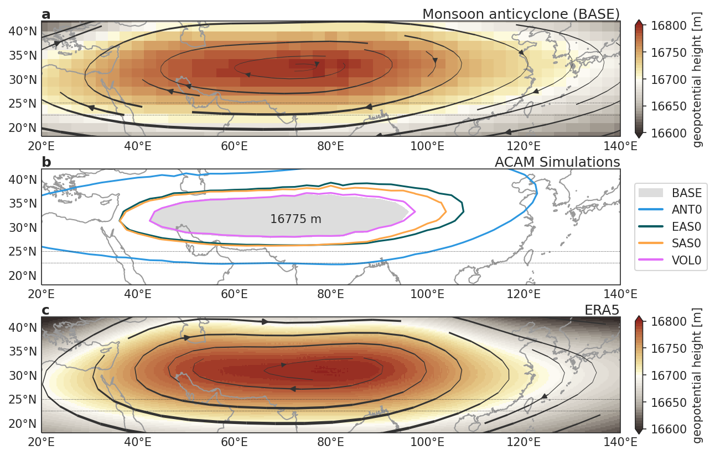
Tsinghua University Community Integrated Earth System Model
anthropogenic aerosols from all sources weaken the monsoon anticyclone
ACAM AeroCom experiments target the effects of Asian aerosols on the monsoon system:
BASE: all emissions
ANT0: no anthropogenic emissions
EAS0: as ANT0 but only over East Asia
SAS0: as ANT0 but only over South Asia
VOL0: no volcanic emissions

Slide 6
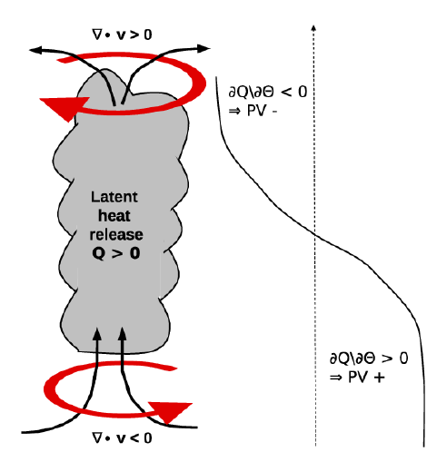

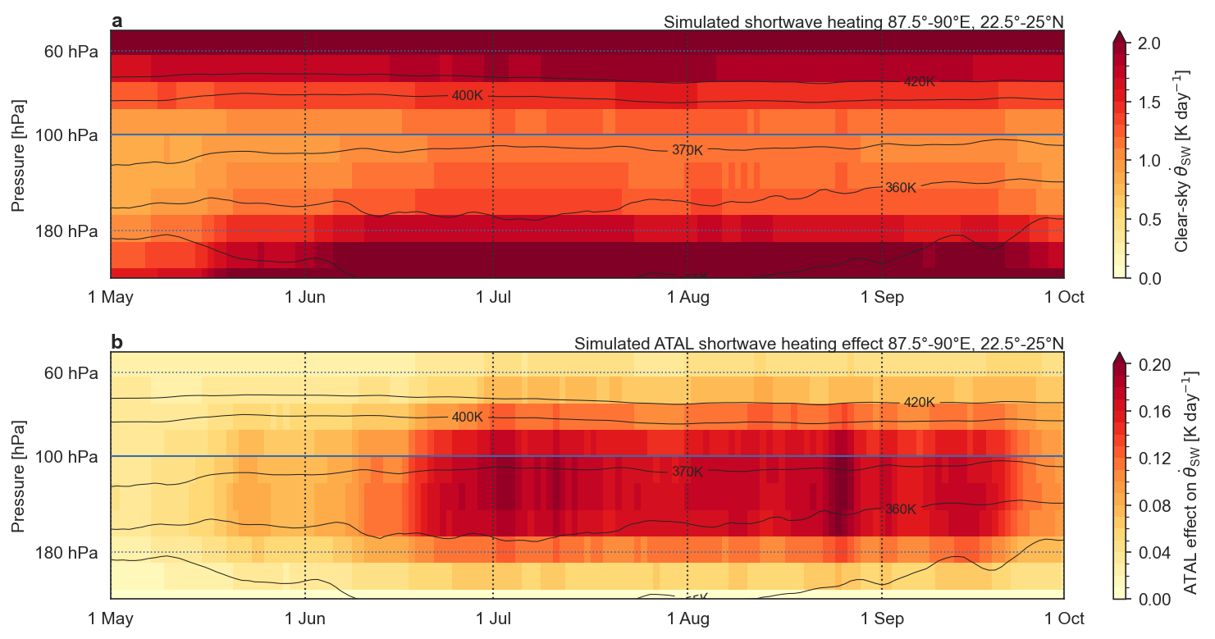

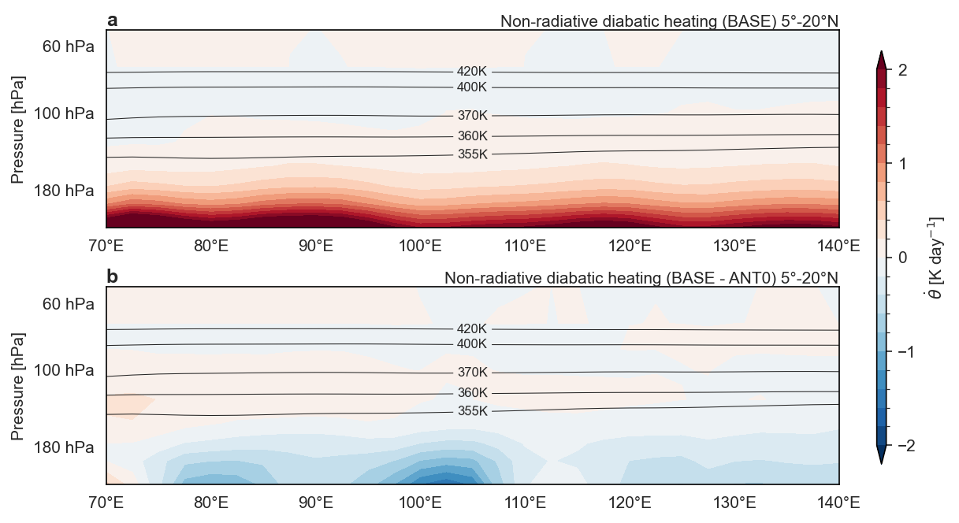
How do aerosols weaken the upper-level anticyclone?
Aerosols absorb sunlight :: longer braking distance
tropopause
Strength of convergence depends on how sharply the brake is applied
vertical convergence drives the anticyclone
Aerosols suppress storms :: slower starting speed
Garny and Randel 2013

Slide 7

Composition-circulation coupling in the Asian monsoon

Slide 8
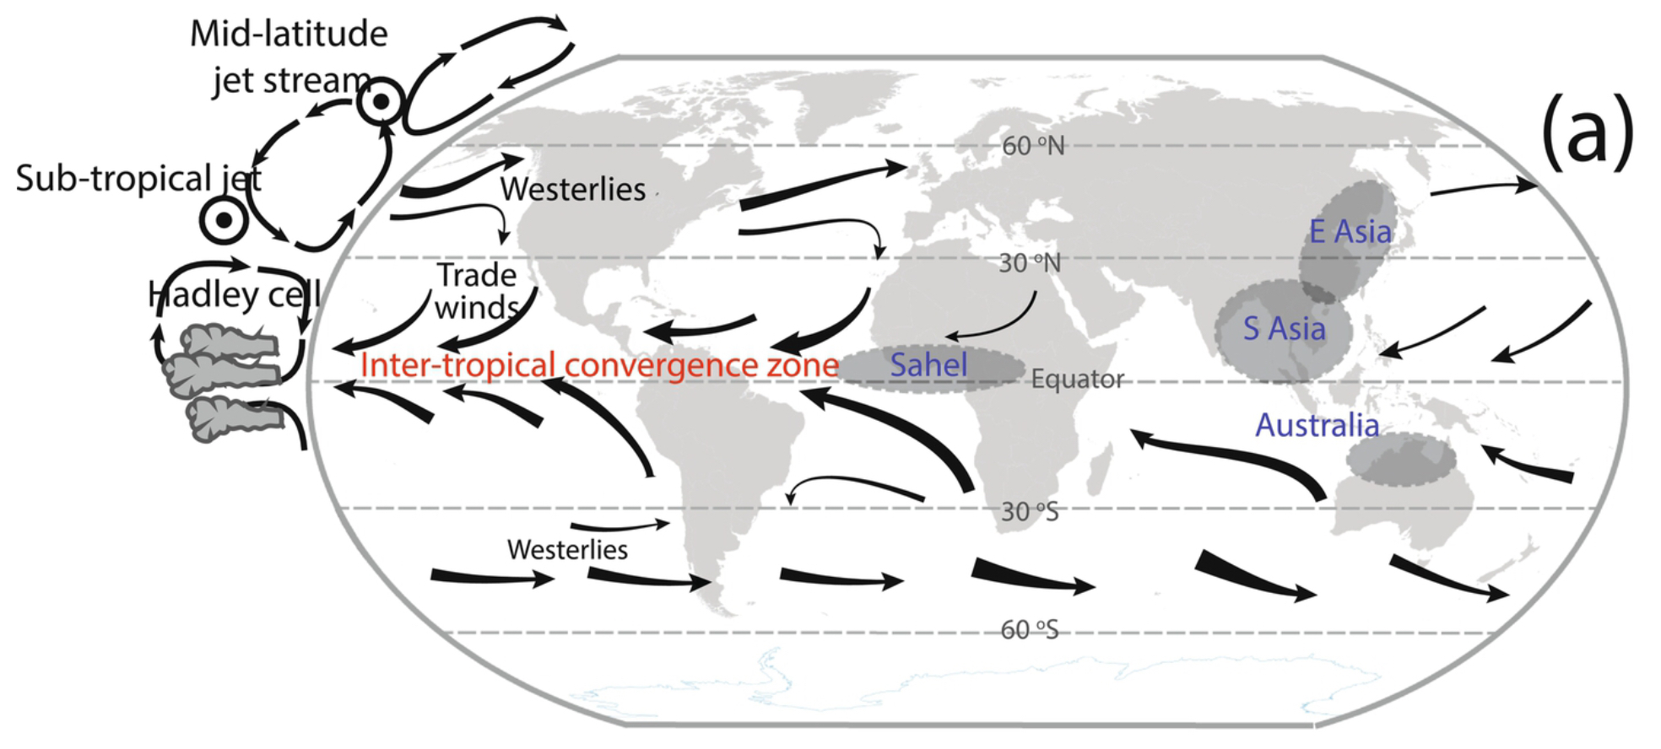

Slide 9

Step 1: Rotation
PGF (perpendicular to geoid)
axis of rotation
sum (toward axis)
gravity (toward center)
Gravity + circular acceleration = effective gravity = PGF
equilibrium for a rotating planet

Slide 10
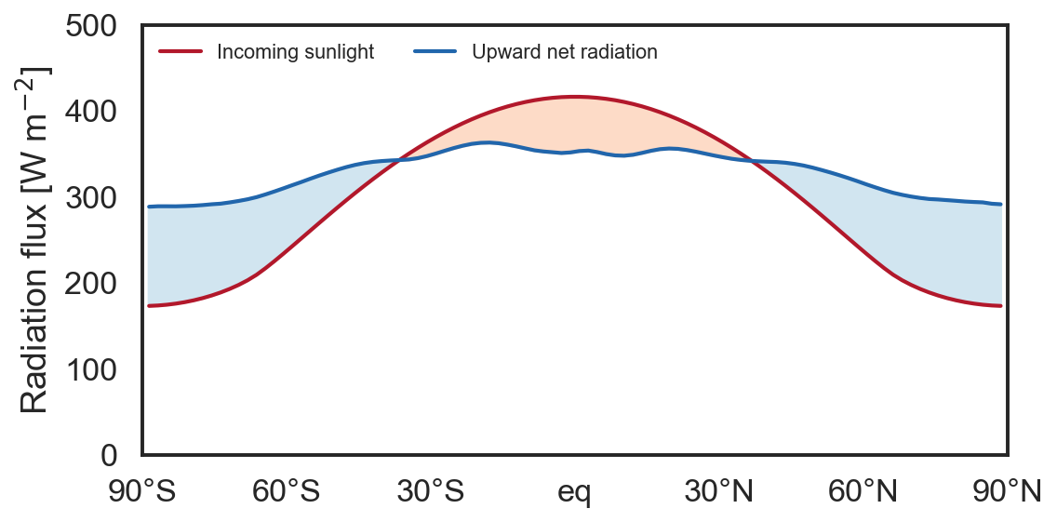
Step 2: Differential Heating
Cool
Heating deficit
Surplus heating: Warm

Slide 11
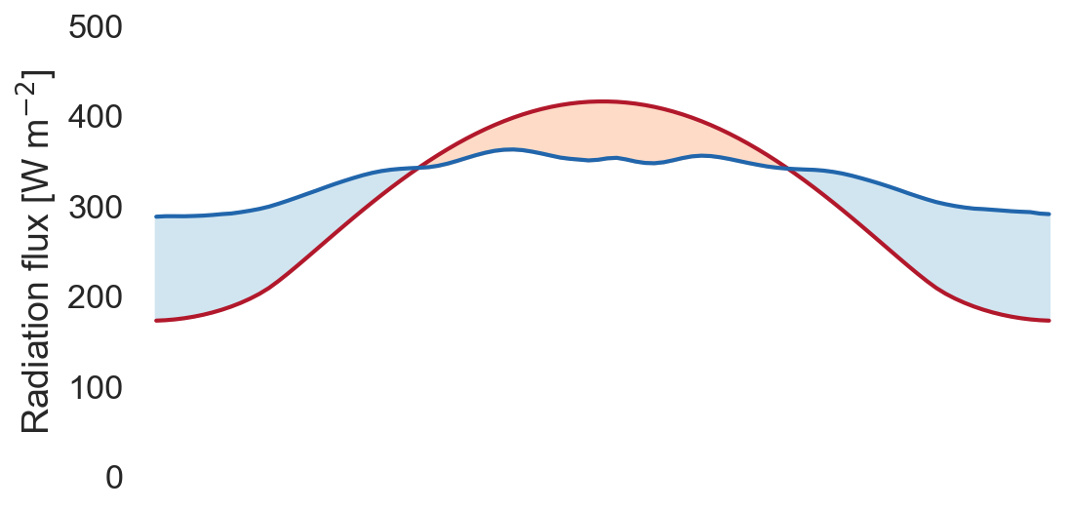
Low
High
Cool
Heating deficit
Differential heating produces a pressure gradient in the near-surface atmosphere: air is heated and pushed upward at low latitudes, resulting in low pressure there and high pressure near the pole
Surplus heating: Warm
Low
H
Thicker atmosphere

Slide 12
Combine Steps 1 & 2: Thermal Wind Balance
warm
Coriolis (differential rotation) + T difference (pressure gradient)
cold
rotates more quickly
•
x
warm
HPG
Thicker atmosphere
rotates more quickly
•
x
The vertical gradient of winds and currents around ‘thicker’ fluid layers like the tropical atmosphere is called the ‘thermal wind’

Slide 13
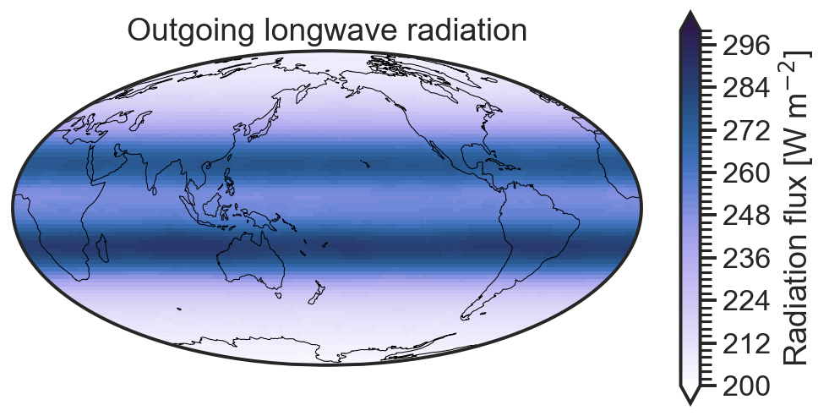
Step 3: Ventilation
“Radiator Fin”:
Sinking air: Subtropical High
H
Clear-sky energy loss → air sinks
Surplus heating: Warm
L
H
Rising motion: Clouds trap energy

Slide 14
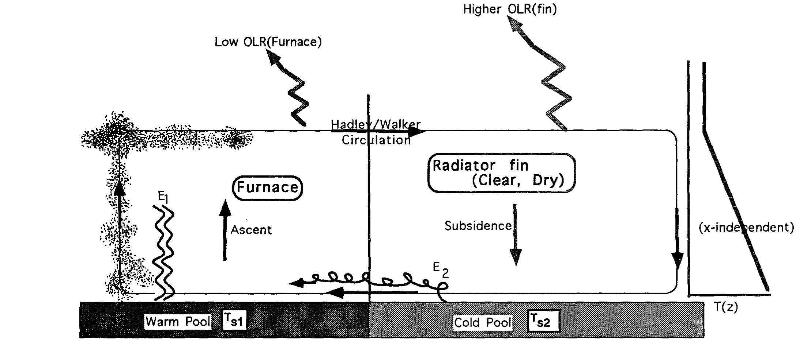
SUBTROPICAL “RADIATOR FINS”
Supplies cold dry air with large potential energy
Releases potential energy to produce warm dry air
Consumes moisture and heat to create potential energy
Supplies warm, moist air (fuel)

Slide 15
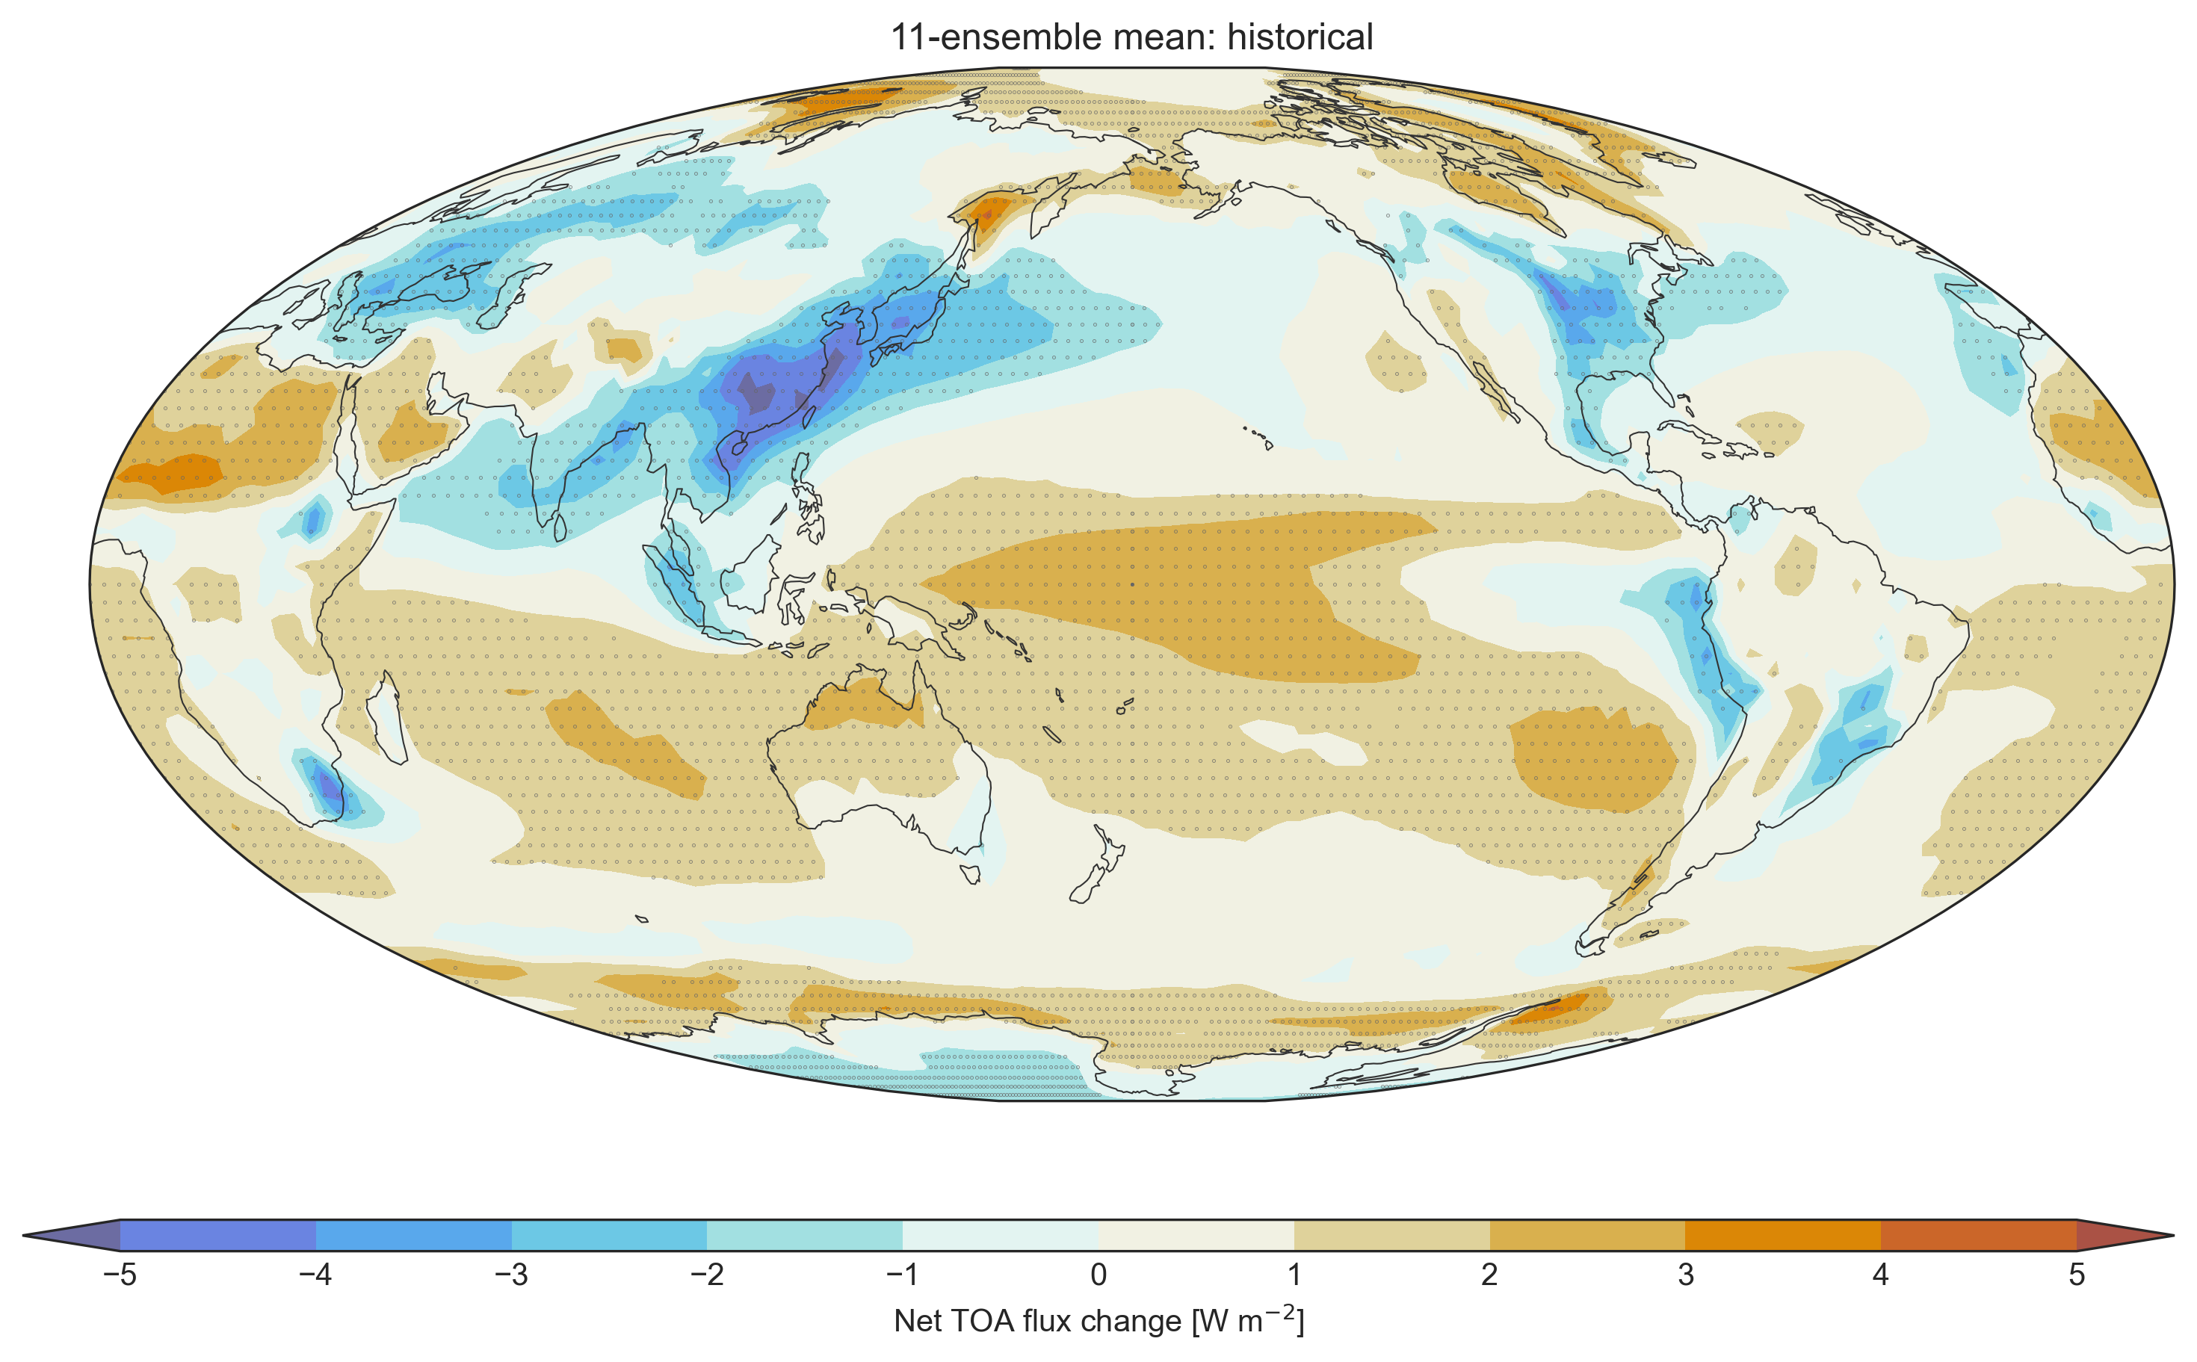
Radiative Forcing
1980-2014 minus 1850-1884

Slide 16
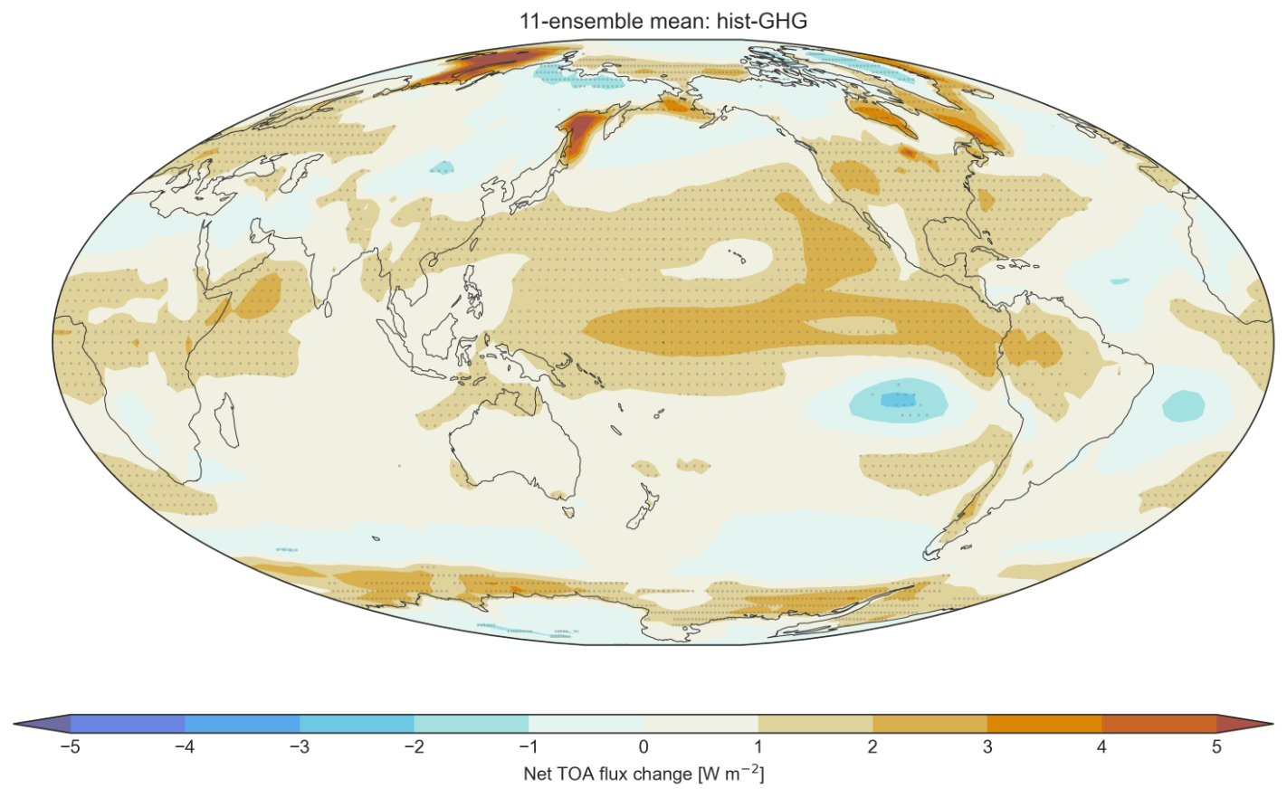
Greenhouse Gases
1980-2014 minus 1850-1884

Slide 17
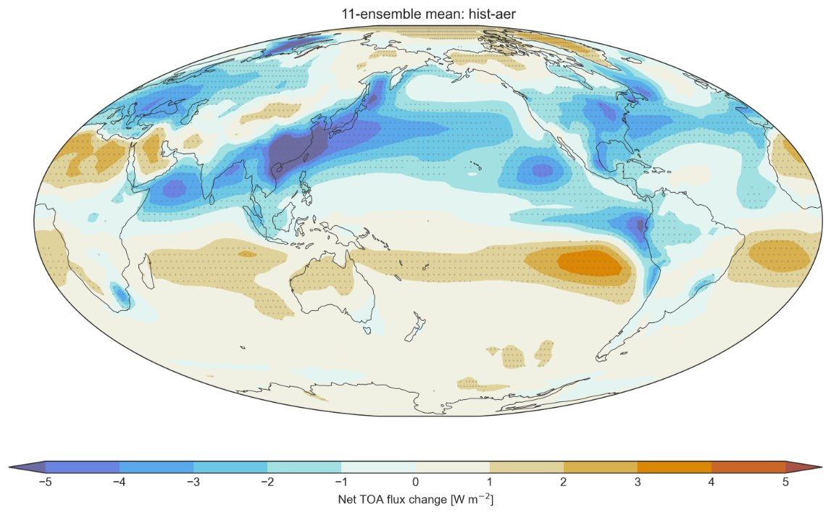
Aerosols
1980-2014 minus 1850-1884

Slide 18
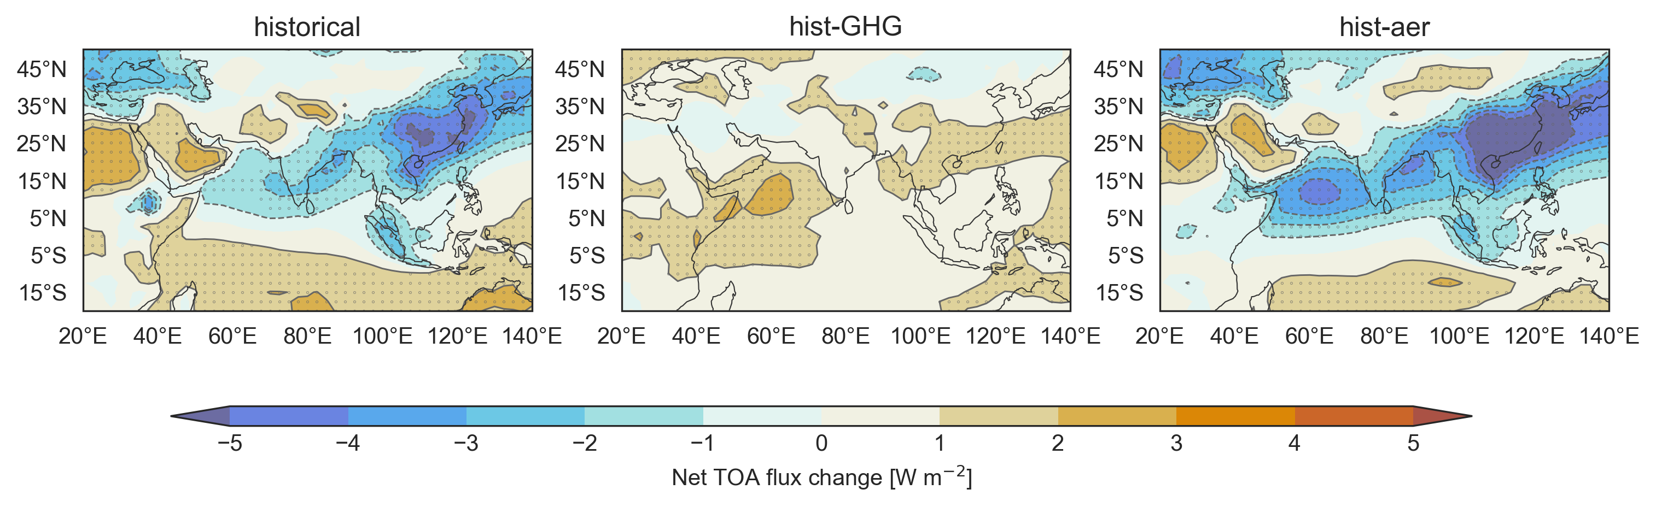
Forcing in the monsoon domain

Slide 19
Toward the monsoon: Heating off the equator
rotate more quickly
warm
•
HPG
warm
cold
rotate more slowly
x

Slide 20
The Simplest Model
Land-sea breeze

Slide 21

The Simplest Model
Land-sea breeze
Daytime
L
land warms up
H
ocean stays cool

Slide 22

The Simplest Model
Land-sea breeze
Nighttime / winter
H
land cools down
L
ocean stays warm

Slide 23
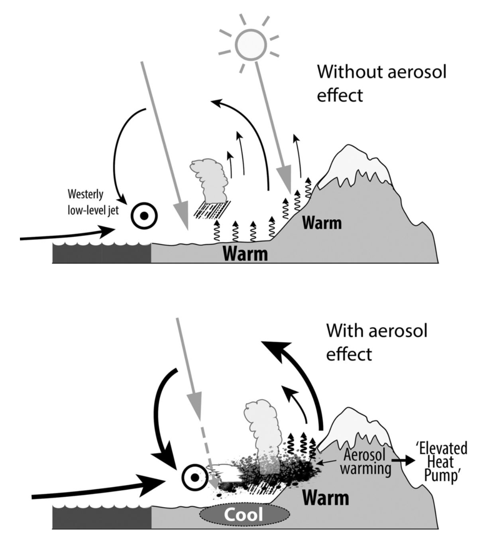
"Elevated heat pump"
Aerosols increase heating in the atmosphere
Pumps more moisture from surrounding oceans
This effect seems to be most important in the pre-monsoon and in La Nina years
In the time mean, aerosols weaken the monsoon – why?

Slide 24
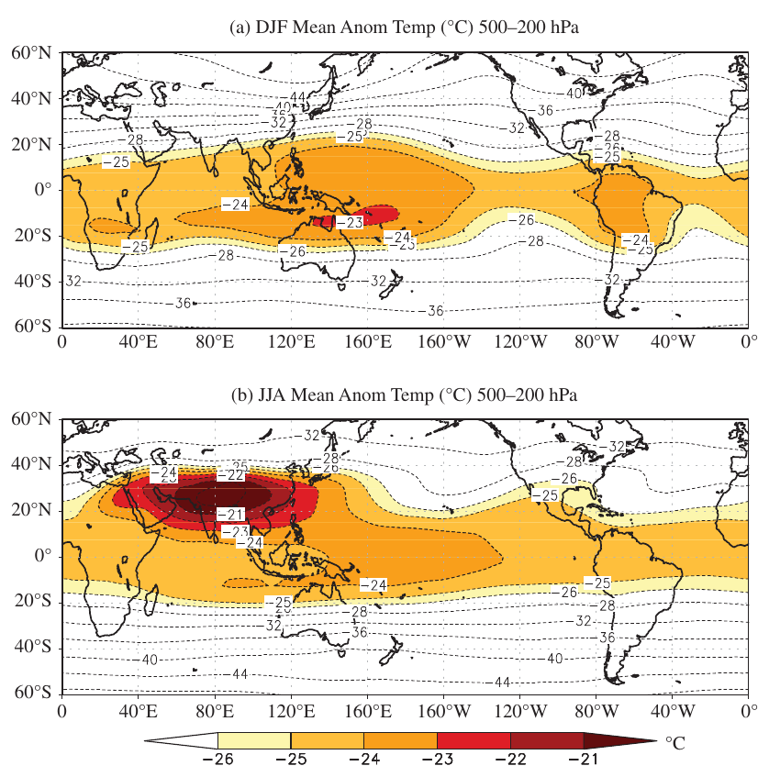
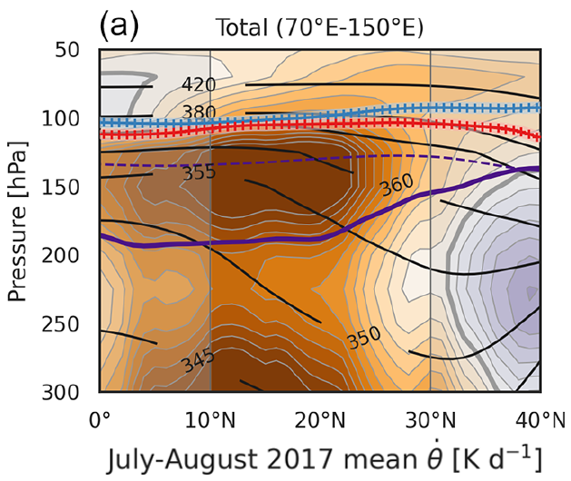
Temperature
In fact, the atmospheric temperature reversal matters more

Slide 25
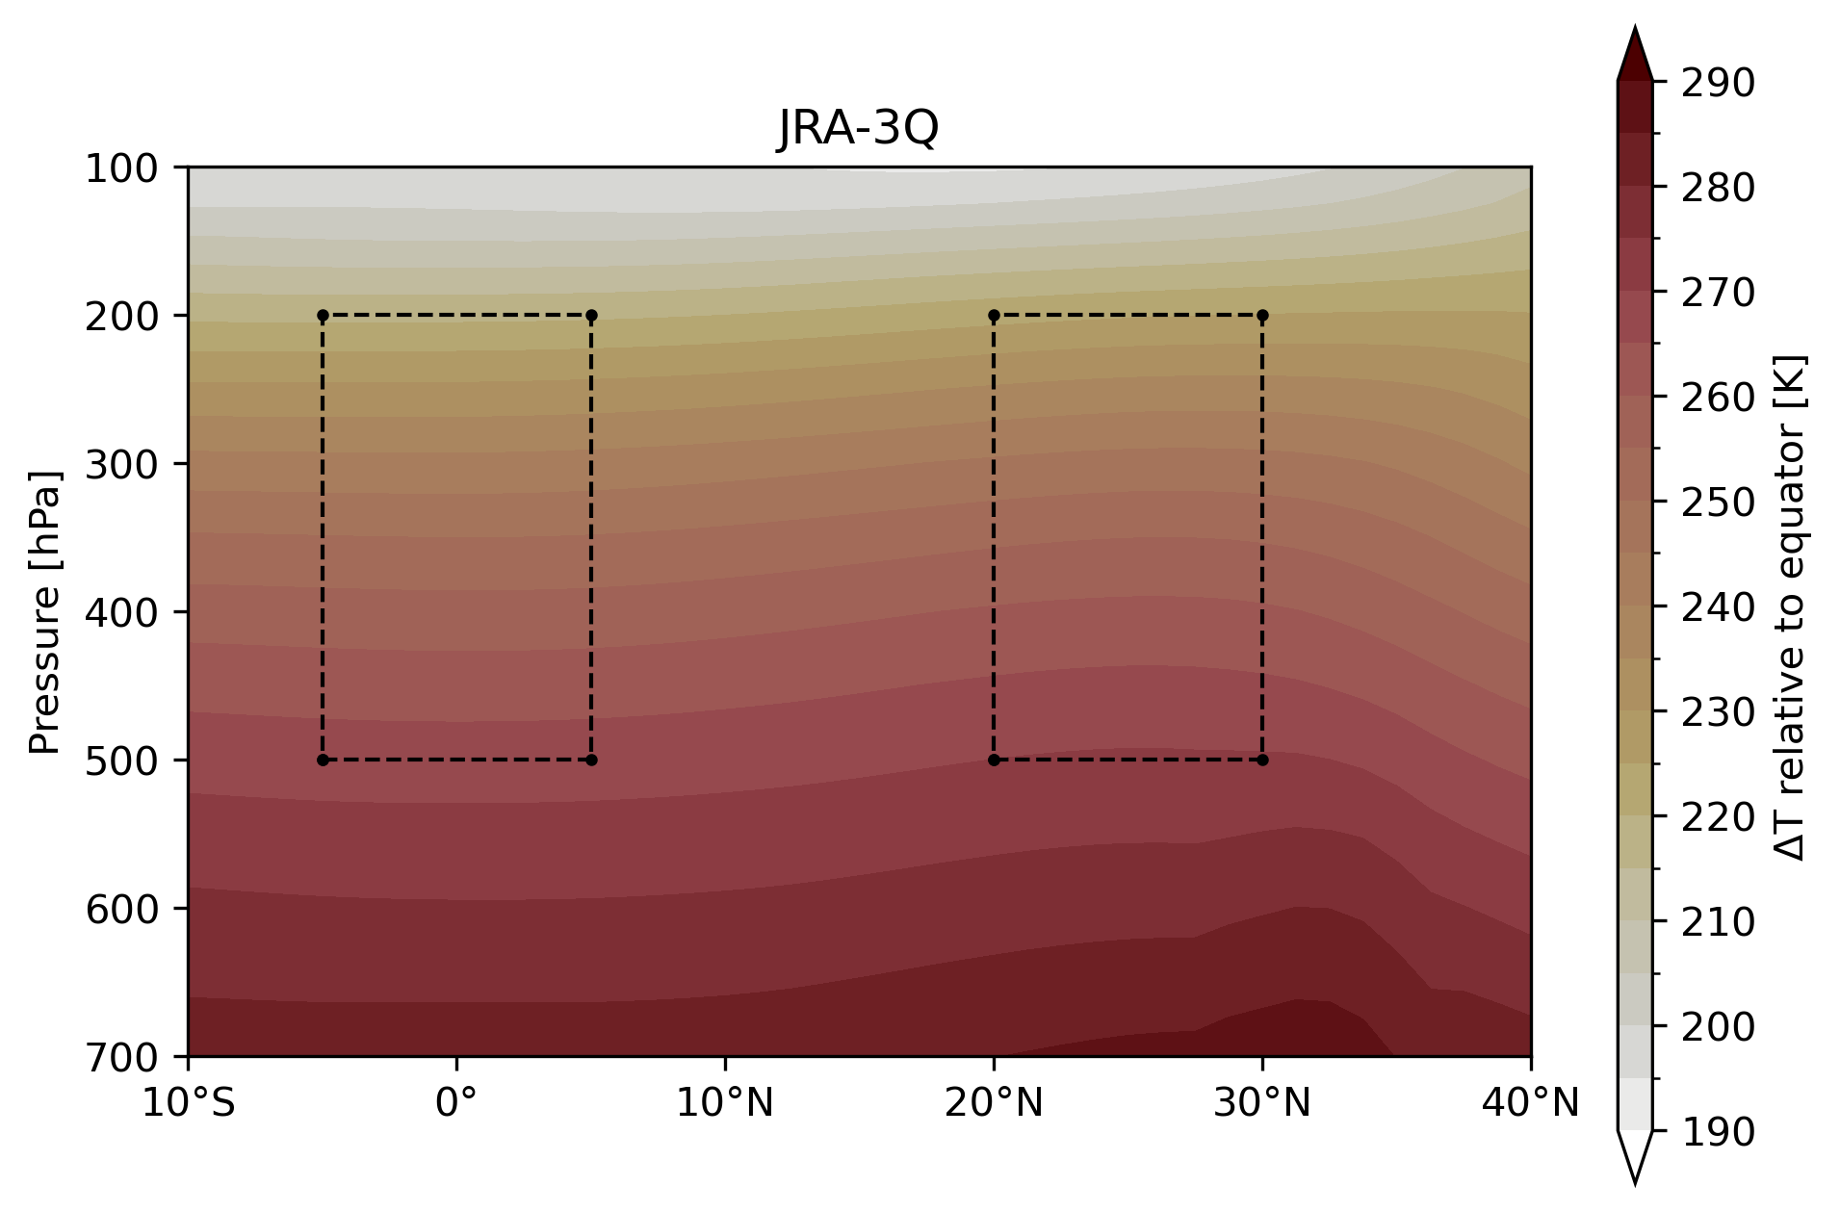
Temperature

Slide 26
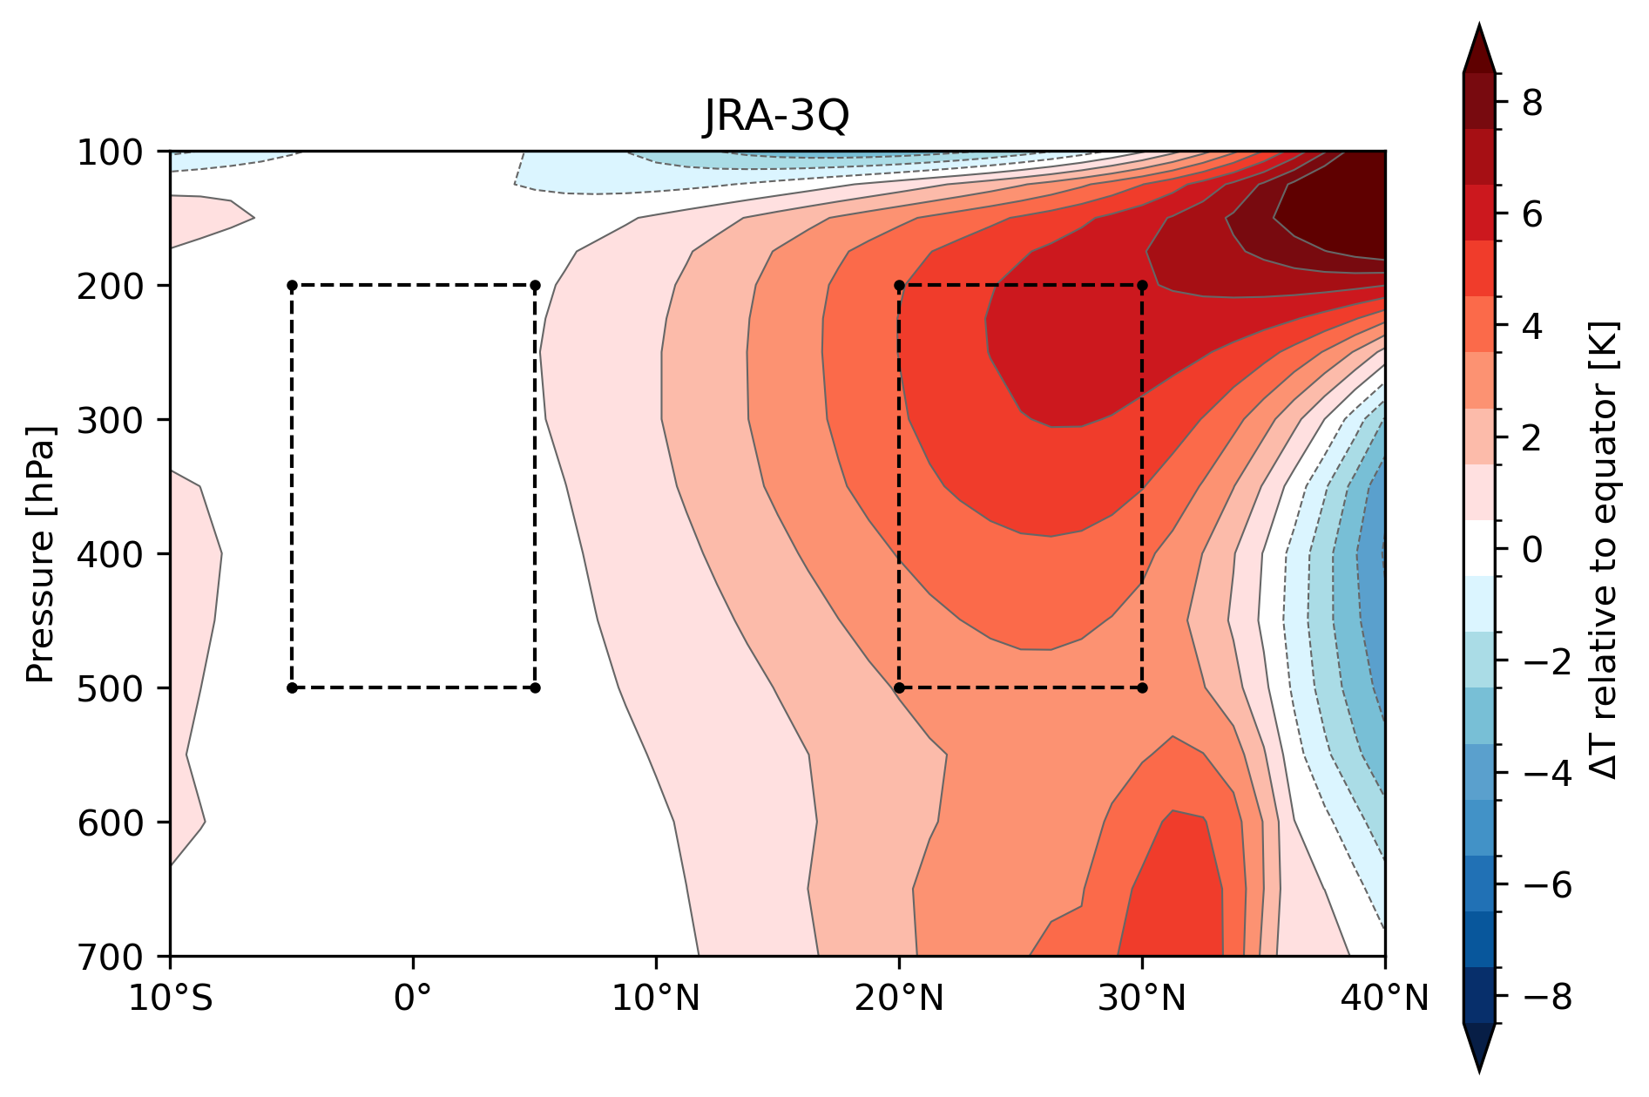
Temperature

Slide 27
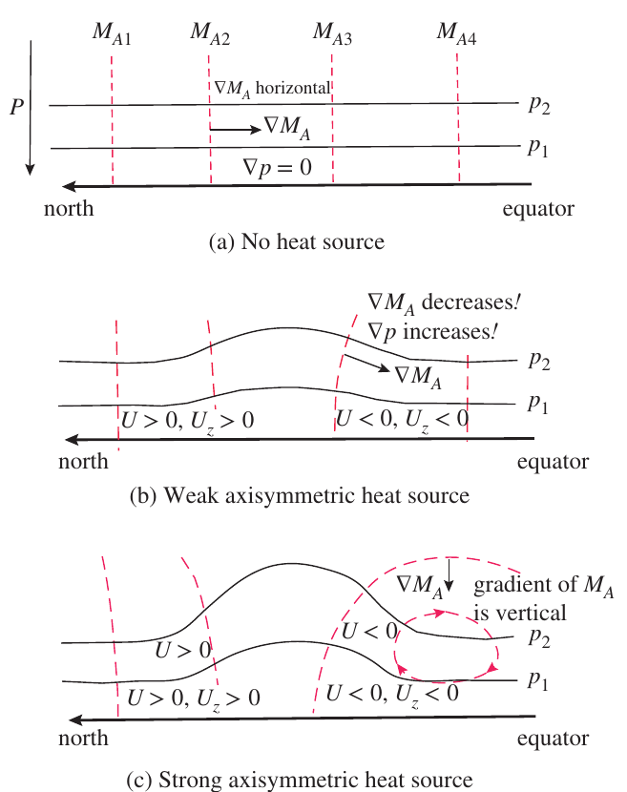
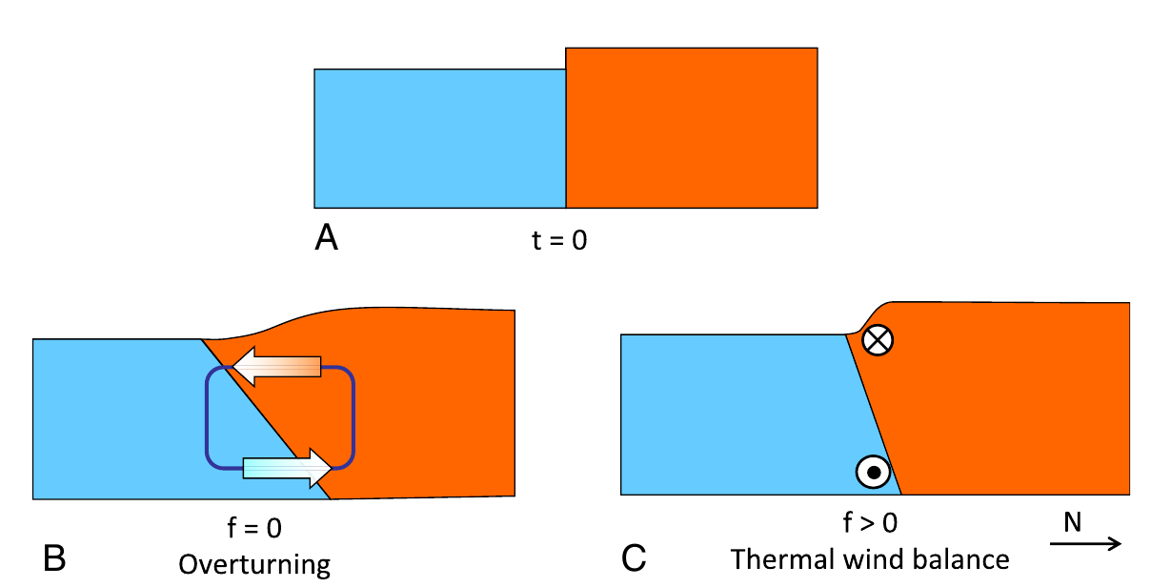
Temperature
Two possible responses to a poleward gradient of upper-level temperature

Slide 28
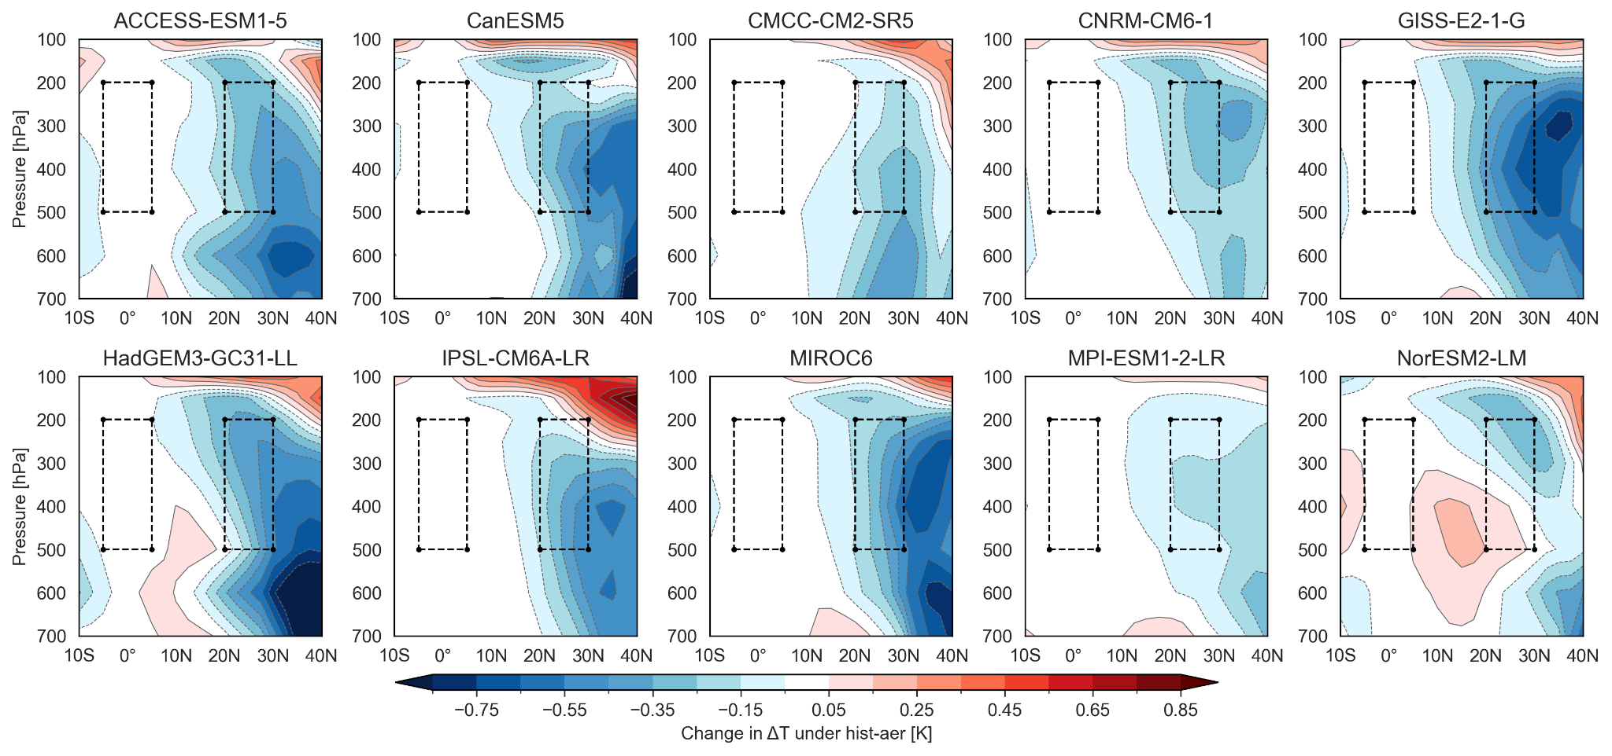
Aerosol response

Slide 29
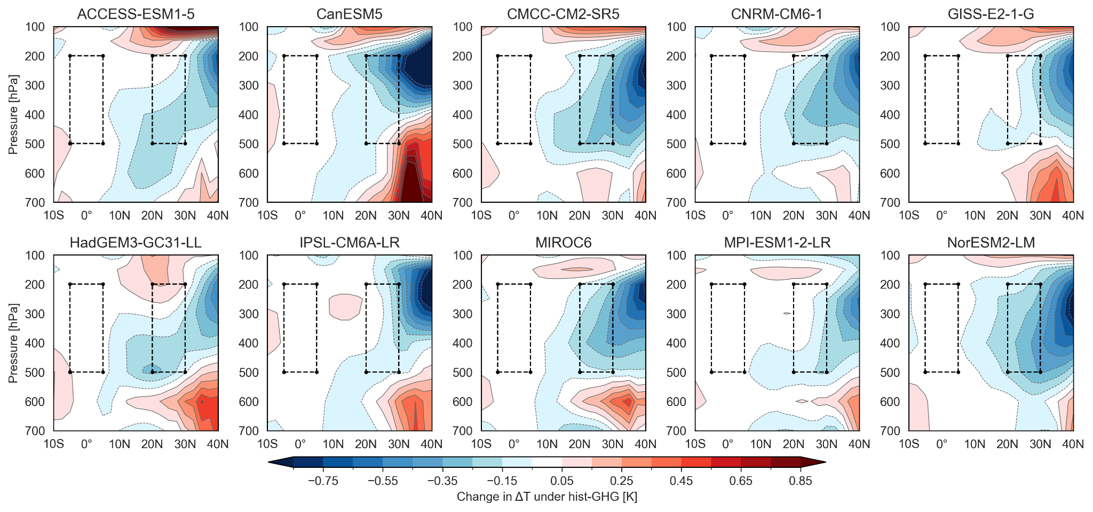
Greenhouse gas response

Slide 30
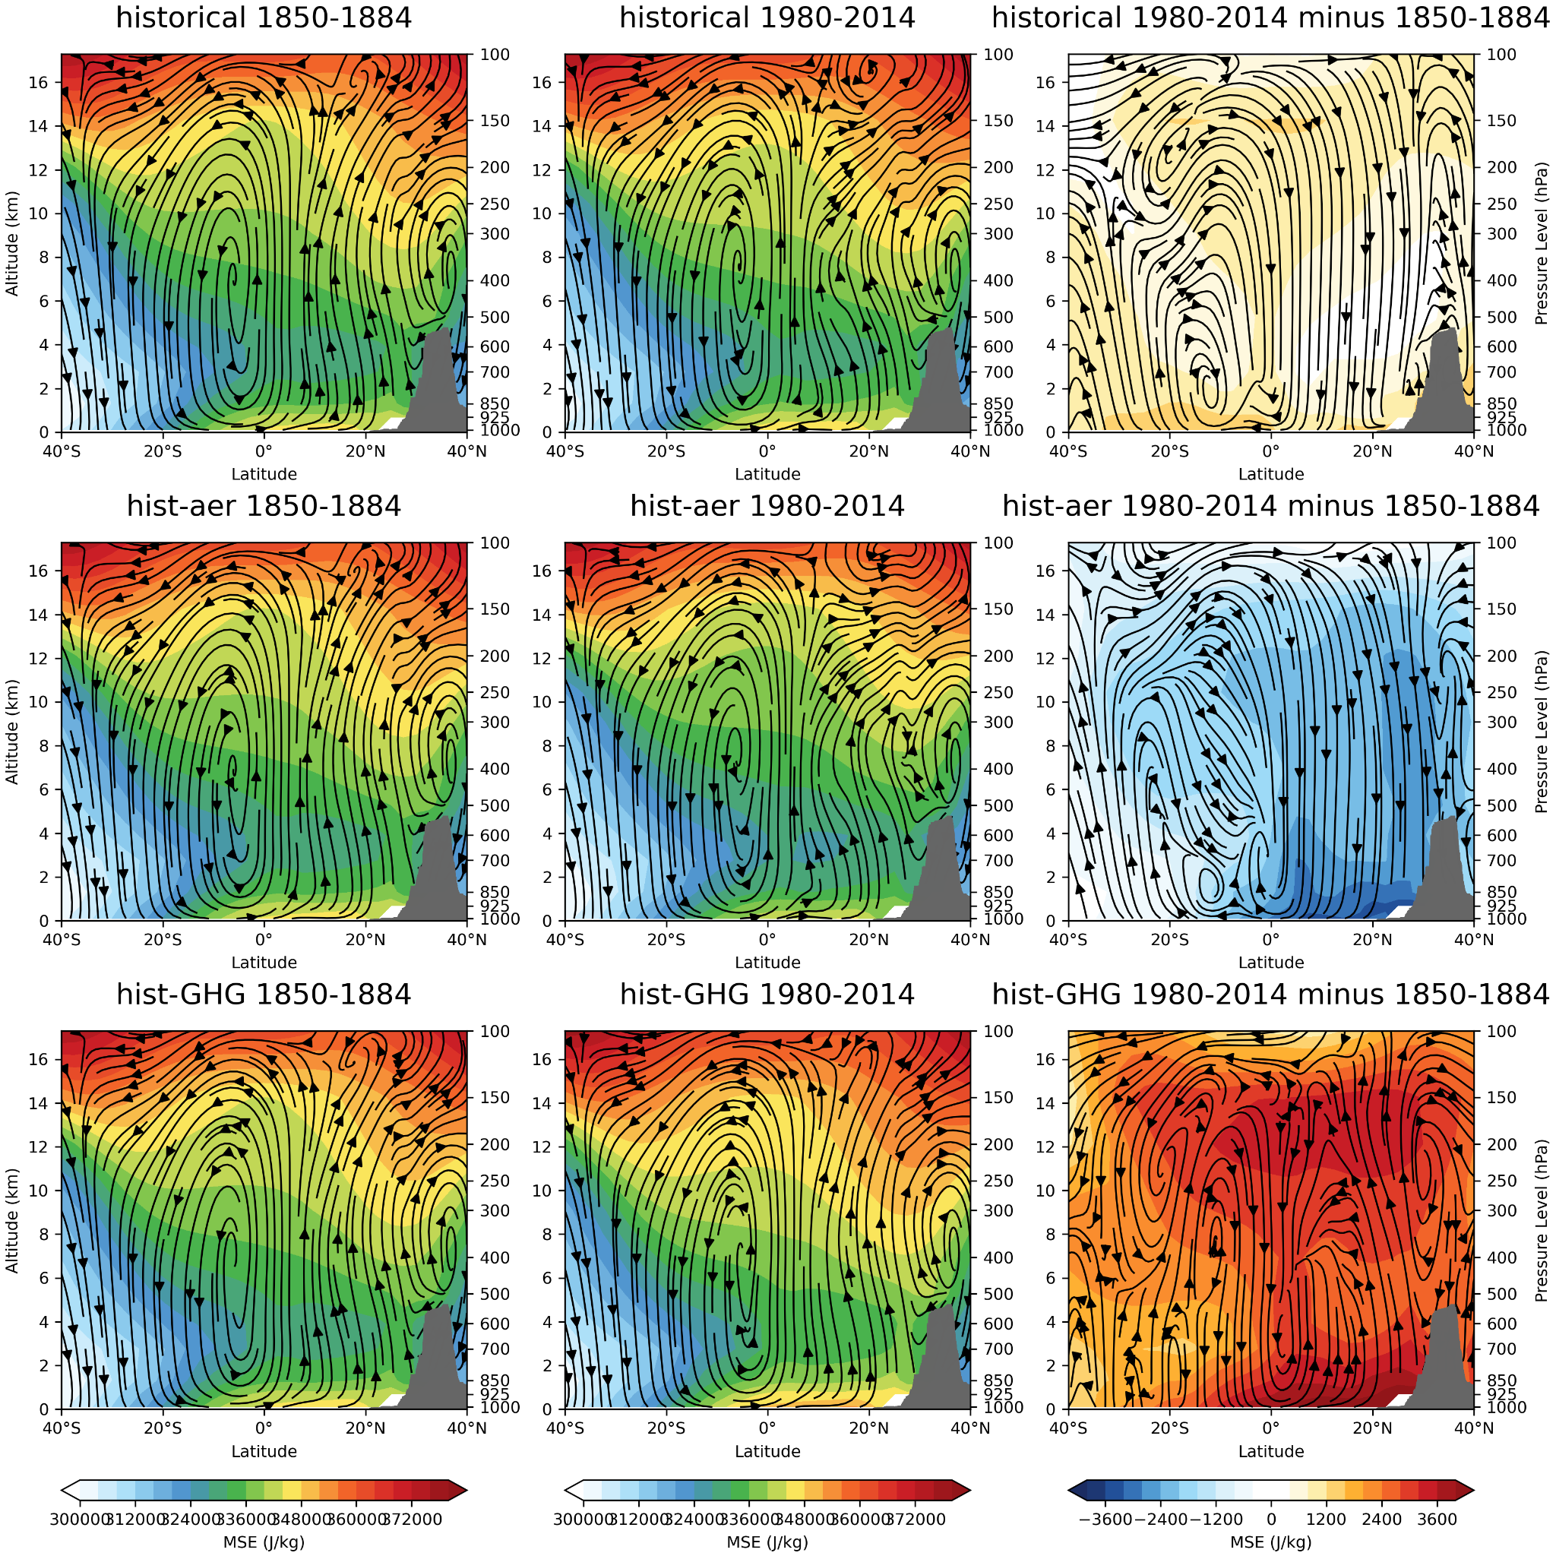
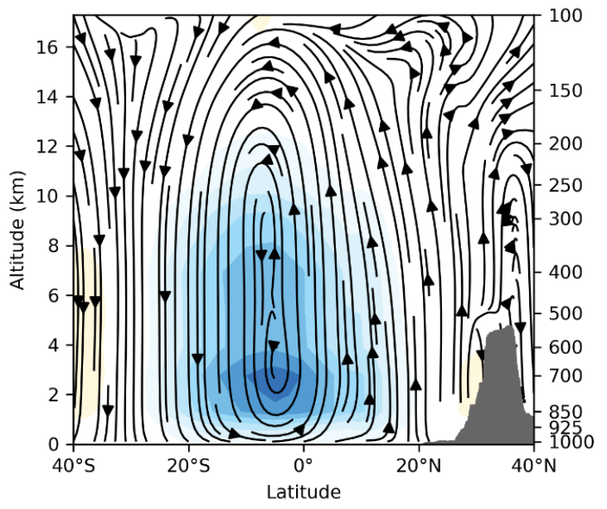
Monsoon Overturning
Moist static energy explains forced changes well

Slide 31
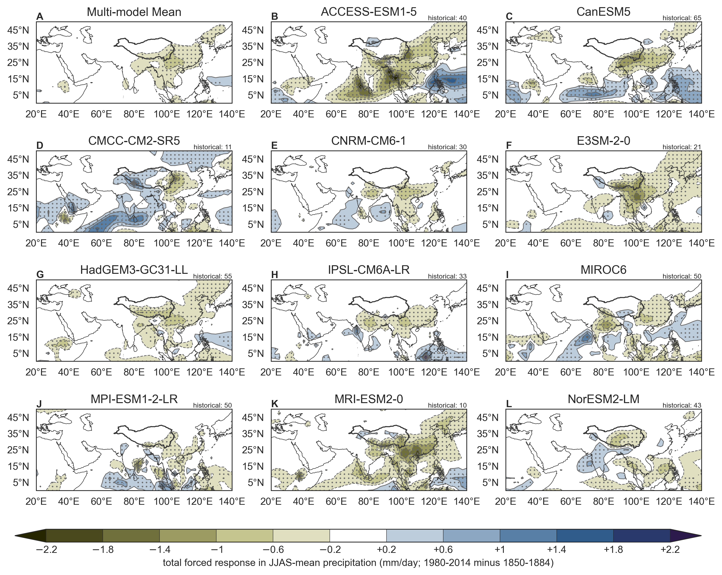
Precipitation
A. Multi-model mean: average the ensemble means
Stippling: >80% of model ensemble means agree on the sign
B-L. Individual models
Stippling: >90% of runs agree on the sign
Change PI – PD
PI period: 1850-1884
PD period: 1980-2014
PI includes all experiments (hist, GHG, aer, totalO3)
PD includes only noted experiments (upper right)

Slide 32
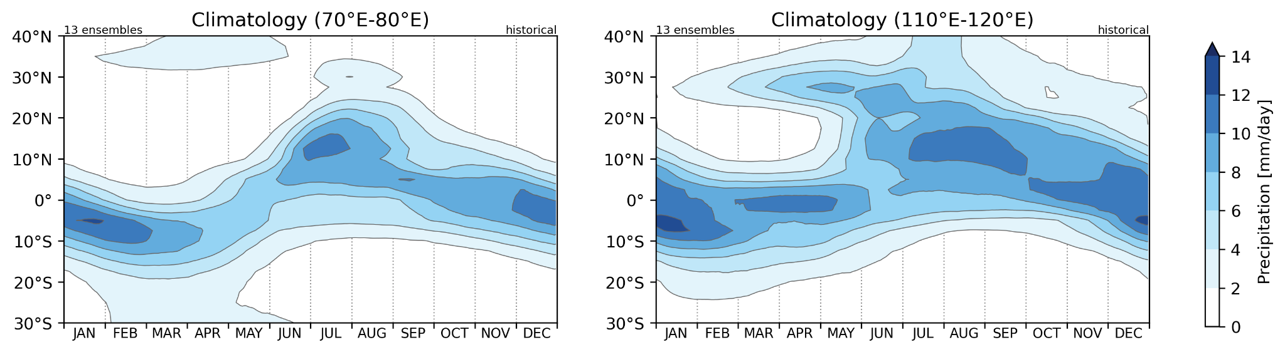
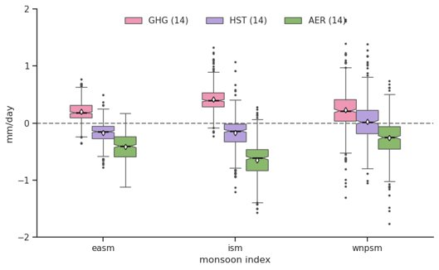
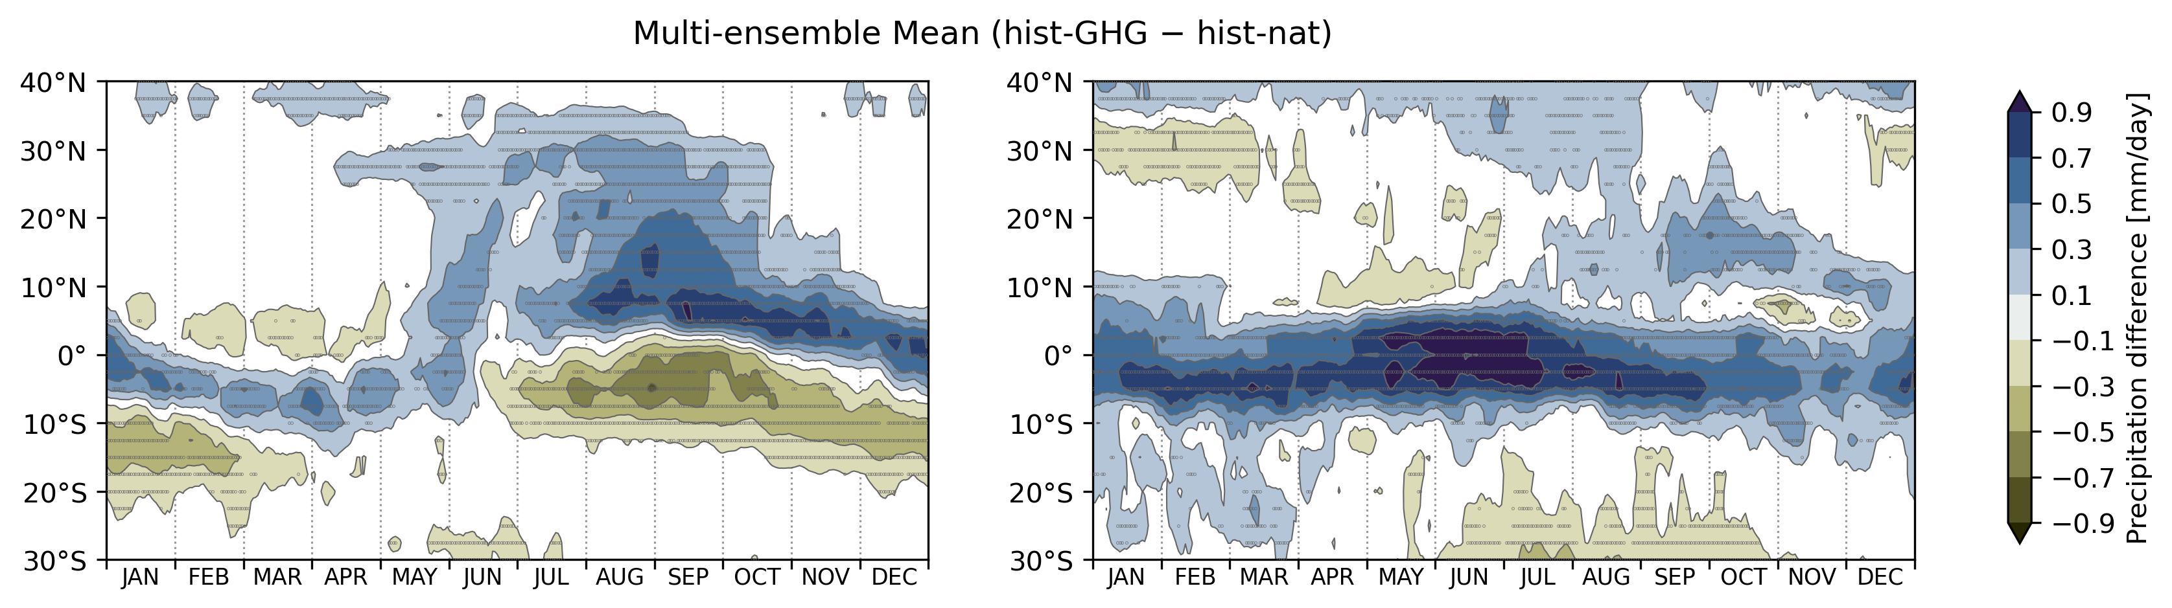
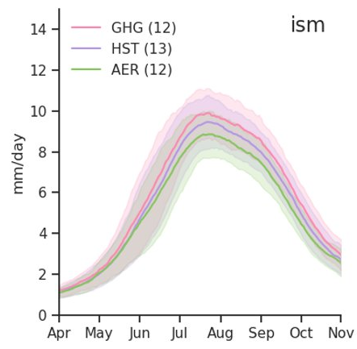
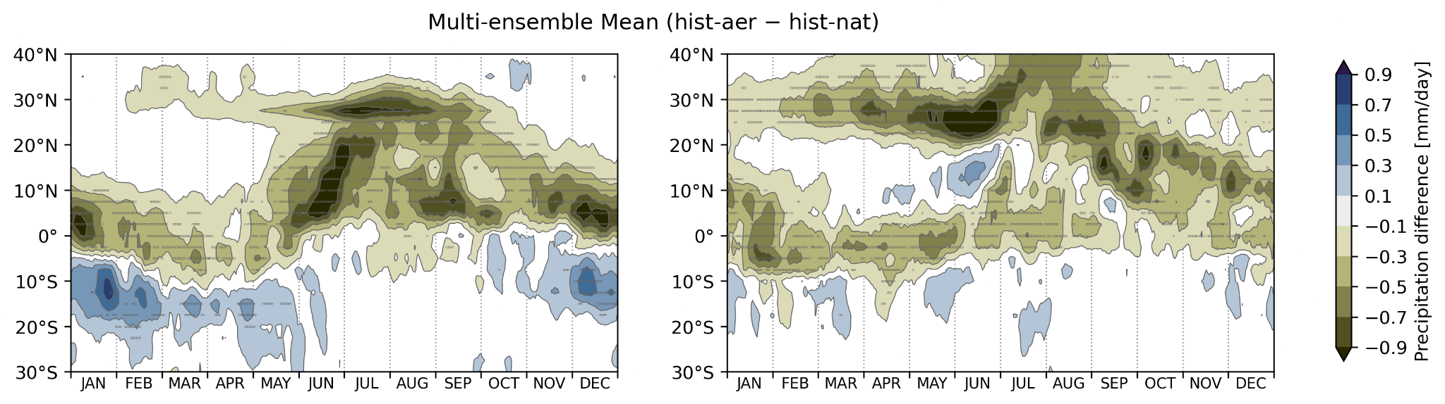
Precipitation
Multi-ensemble mean GHGs response
Multi-ensemble mean aerosol response

Slide 33
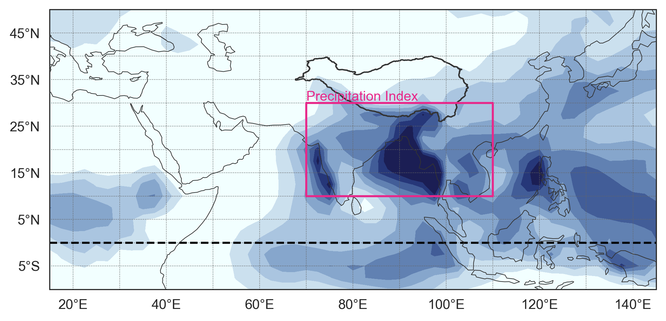
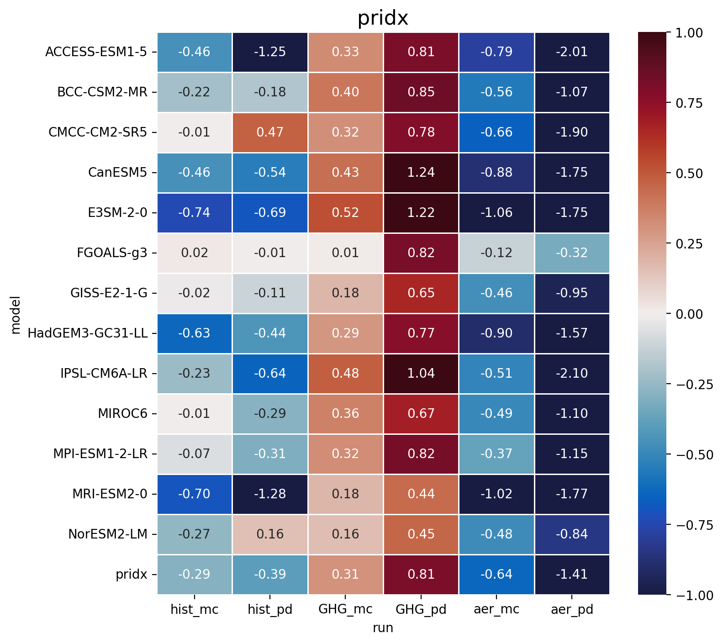
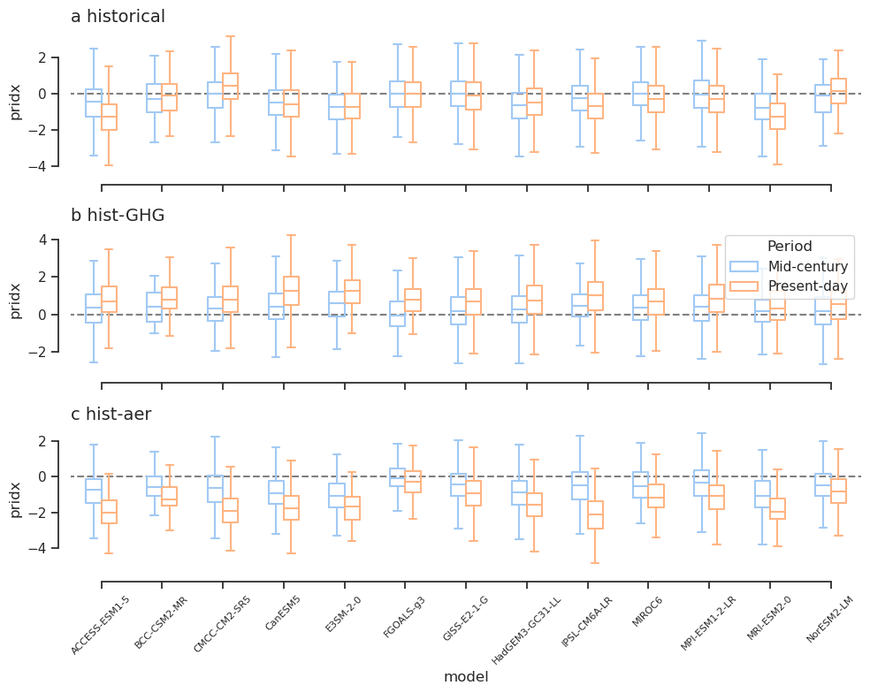
Precipitation index
Greater consistency in this index

Slide 34
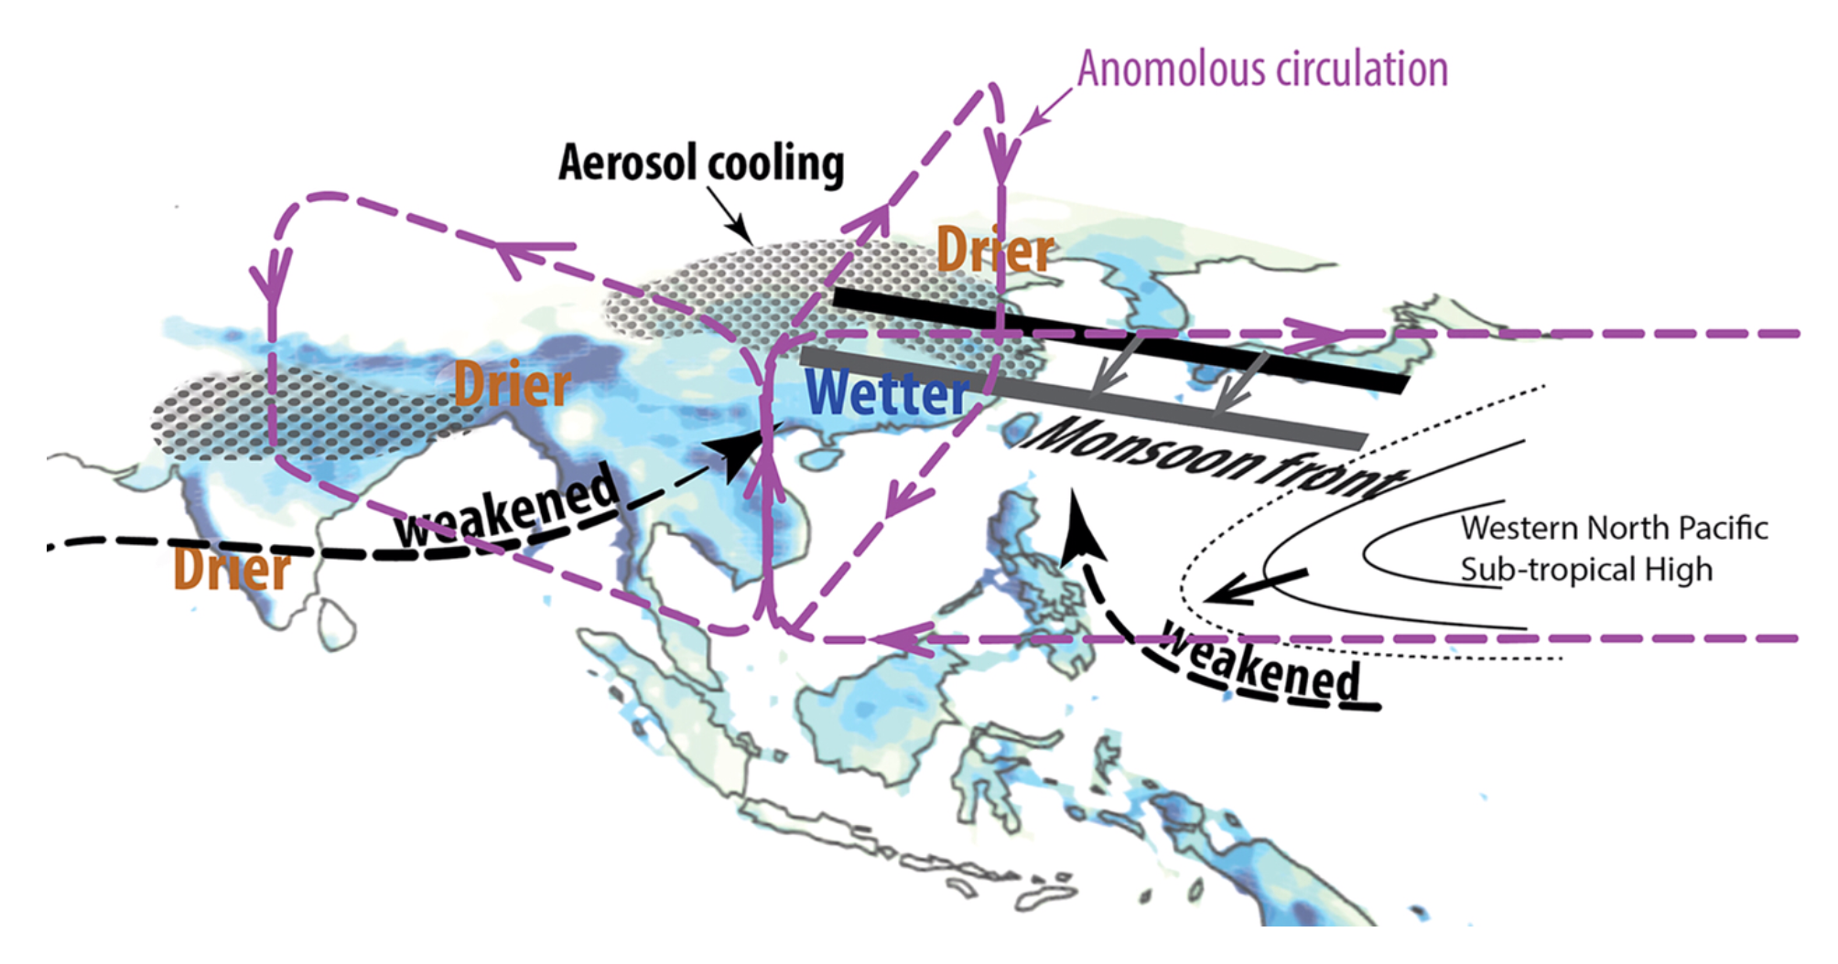

Slide 35
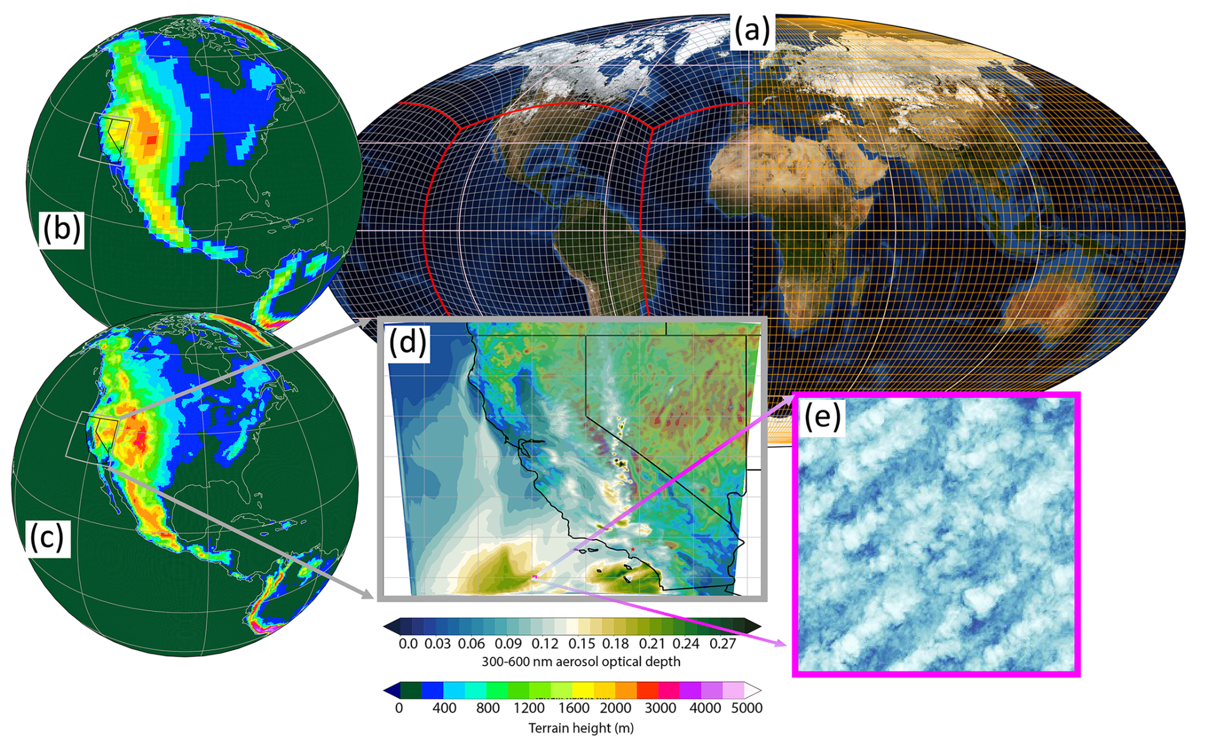
Models: the hierarchy
Global
Regional
Cloud-resolving
Large-eddy
Level of complexity
Aerosols? Chemistry?

Slide 36
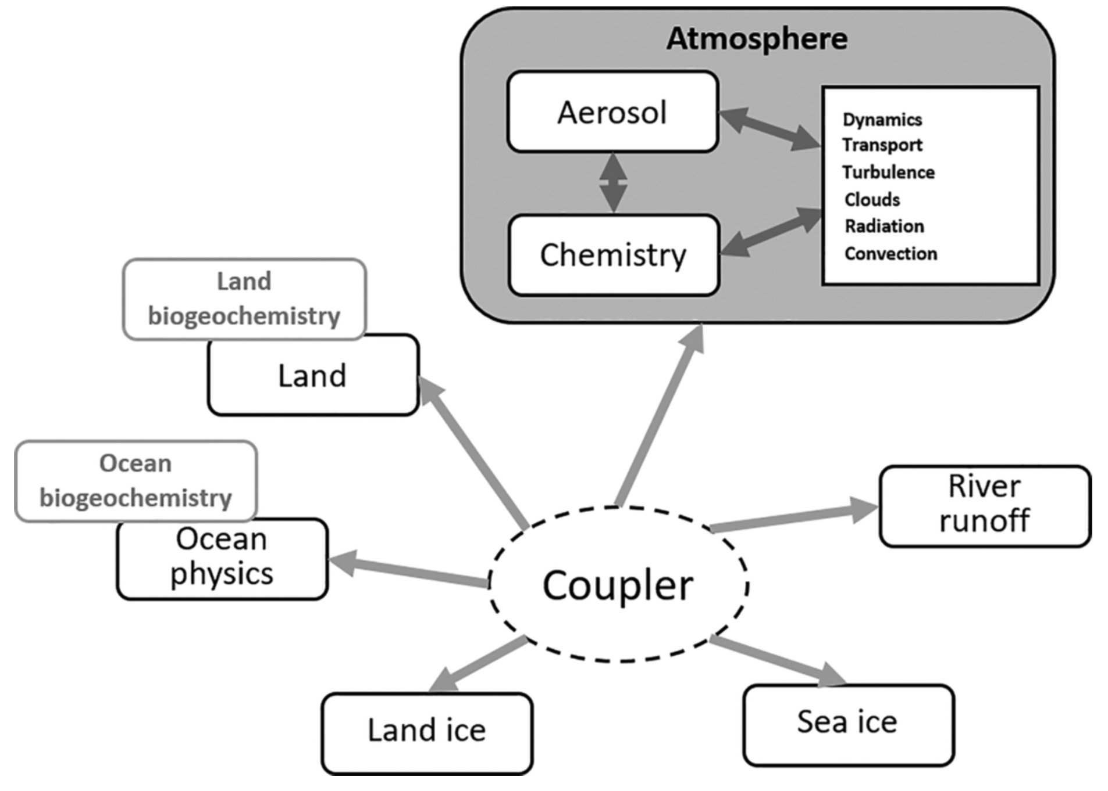

Slide 37


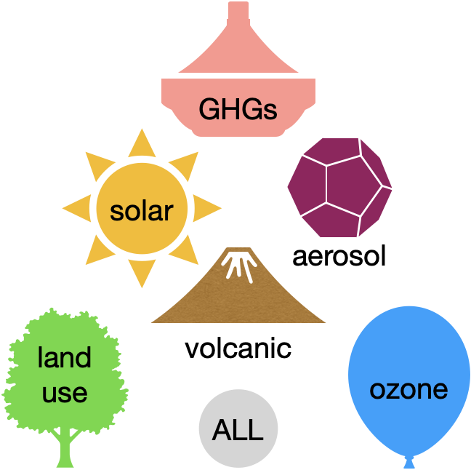

LEADER + EPESC
Large Ensembles for Attribution of Dynamically-driven ExtRemes
LARGE ENSEMBLE
SINGLE FORCING
MIP
Many realizations of each model scenario
Each scenario includes only a single forcing agent
Many different climate models are considered
How do monsoons vary?
Why have monsoons changed?
Where do models agree?

Slide 38



MODEL WORLD
“REAL WORLD”
MODELS
REANALYSIS
OBSERVATIONS
Where Reanalysis Products Fit

Slide 39
what a reanalysis is:
a best estimate

Slide 40
what a reanalysis is not:
observational “truth”

Slide 41
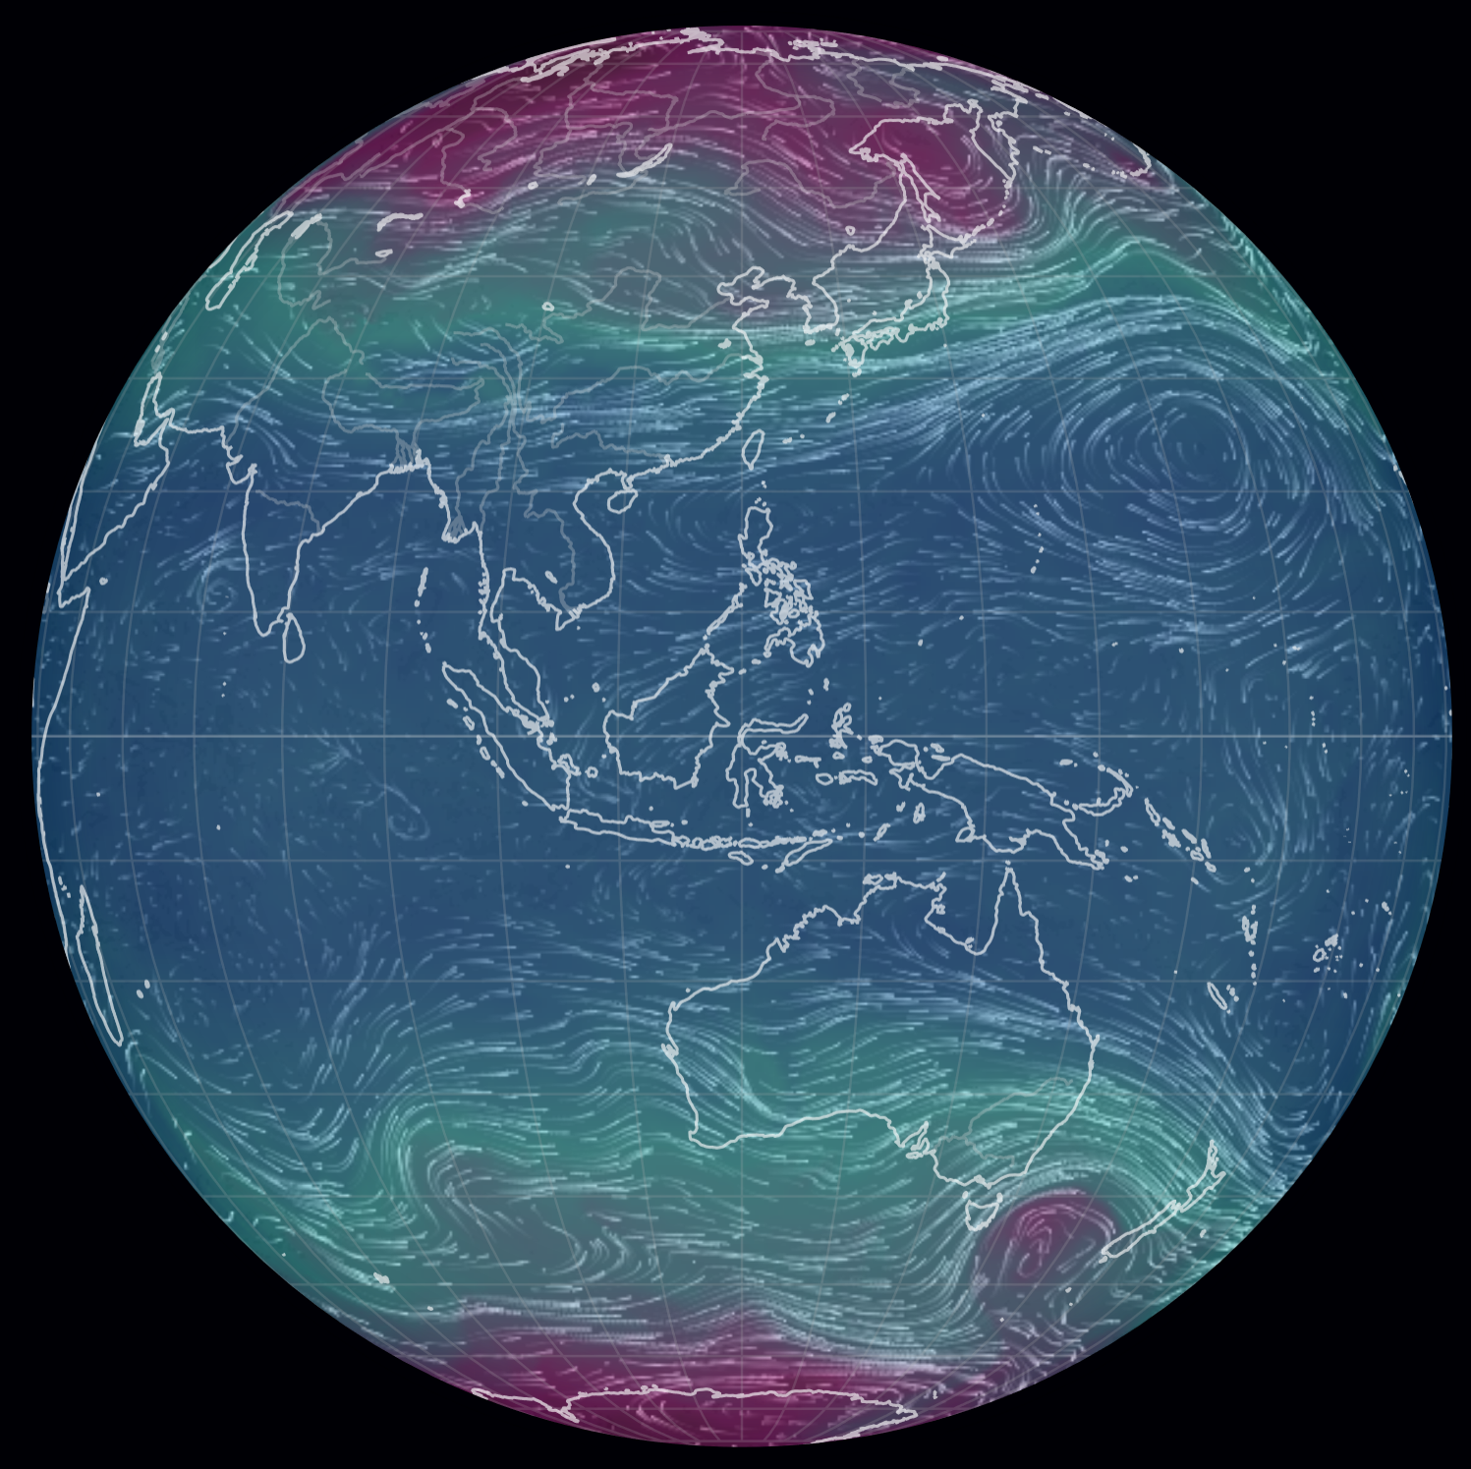



WHAT IS A REANALYSIS?
FORECAST MODEL
Usually a well-tested version of a weather forecast model
Fixed over the lifetime of the reanalysis
Includes dynamical core, parameterized physics, prescribed forcings and boundary conditions, land surface model...
DATA ASSIMILATION SYSTEM
Combine model forecasts and observations
Fixed over the lifetime of the reanalysis
Account for known errors and uncertainties in both model and observations
Only a few variables are directly impacted
INPUT OBSERVATIONS
Reanalyses can be classified by inputs: surface (surface pressure and/or winds), conventional (+radiosondes, aircraft), or full (+satellites)
Quality and quantity of observations vary in time

Slide 42
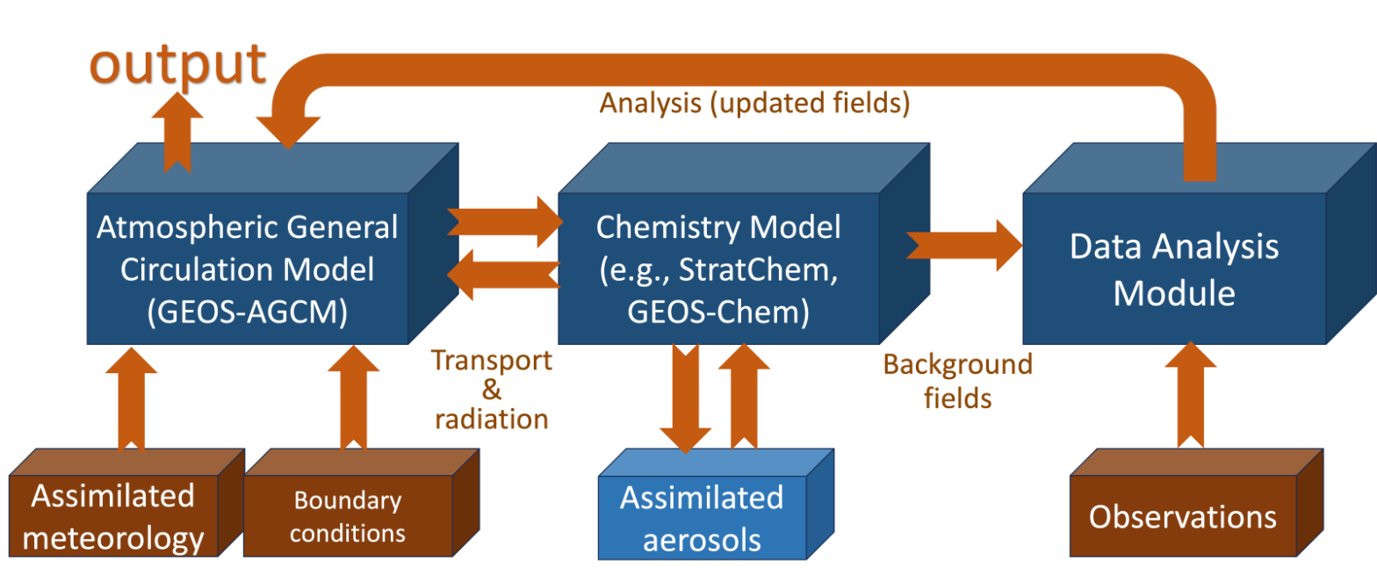
Reanalyses of Atmospheric Composition

Slide 43

Reanalysis system | Period | Source | Focus area | Grid spacing | Levels
CAMS-EAC4 | 2003 – 2021 | ECMWF | Whole atmosphere | 0.75°×0.75° | 60
BRAM2 | 2004.09 – 2019.08 | BIRA-IASB | Stratosphere | 2.5°×3.75° | 37
M2-SCREAM | 2004.10 – 2021.12 | NASA GMAO | Stratosphere | ~50km | 72
TCR2 | 2005 – 2019 | NASA JPL | Troposphere | T106 (1.1°) | 32
Detailed information on atmospheric composition variations in troposphere, stratosphere, or both
Observational information mainly from satellite sensors (O₃, NO₂, CO, HNO₃, SO₂, AOD, …)
Chemistry-climate models of varying complexity
Larger differences in assimilation methods and constraints
Constraints on vertical profiles are generally weak
Meteorological reanalyses provide O₃ but with simpler models
Also separate aerosol analyses in MERRA-2, CAMS, etc.

Slide 44
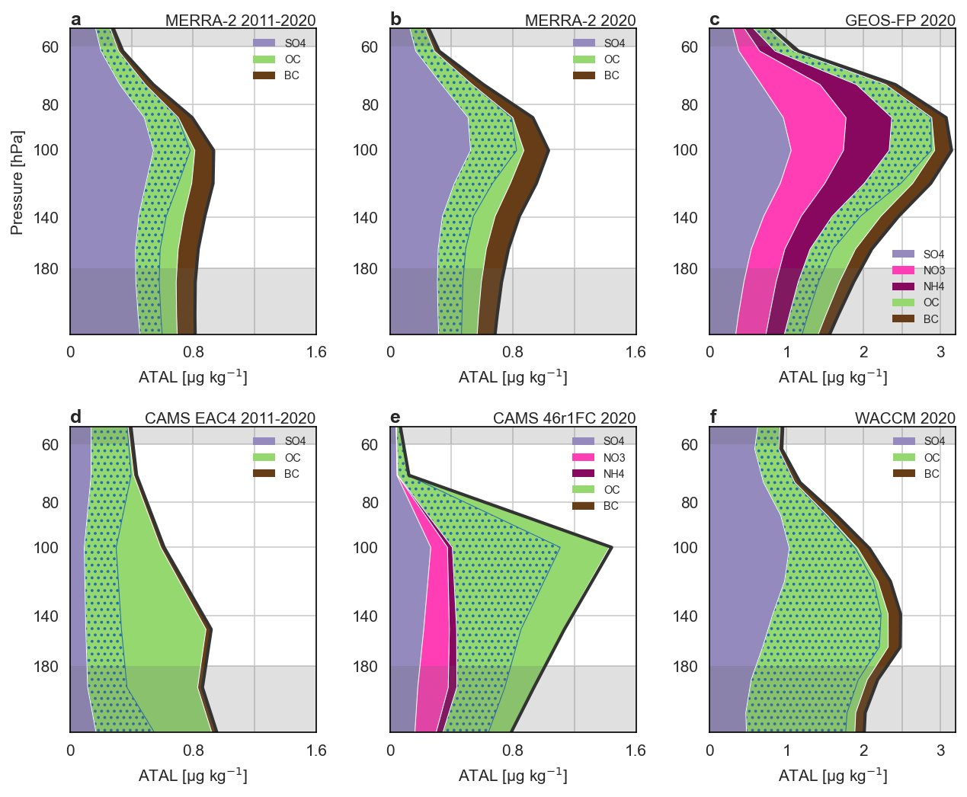
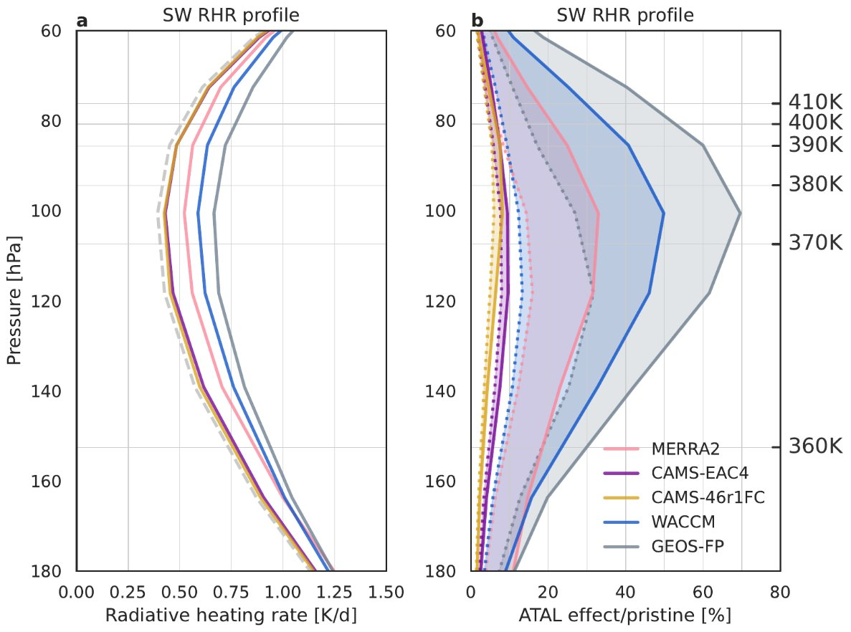
Aerosol reanalyses subject to large uncertainties
Only AOD assimilated; nitrates only starting to be represented
Column, good coverage
Near-global, high vertical resolution
Sparse, high vertical resolution
Column, good coverage
Near-global, high vertical resolution
Sparse, high vertical resolution
MLS: Microwave Limb Sounder on NASA’s EOS Aura; observations of stratospheric composition profiles
OMI: Ozone Monitoring Instrument on EOS Aura; observations of total column ozone
OMPS: Ozone Monitoring and Profiler Suite on Suomi NPP and NOAA satellites; total and profile ozone
MLS: Microwave Limb Sounder on NASA’s EOS Aura; observations of stratospheric composition profiles
OMI: Ozone Monitoring Instrument on EOS Aura; observations of total column ozone
OMPS: Ozone Monitoring and Profiler Suite on Suomi NPP and NOAA satellites; total and profile ozone
MLS: Microwave Limb Sounder on NASA’s EOS Aura; observations of stratospheric composition profiles
OMI: Ozone Monitoring Instrument on EOS Aura; observations of total column ozone
OMPS: Ozone Monitoring and Profiler Suite on Suomi NPP and NOAA satellites; total and profile ozone

Slide 45
Observations
Sensor | Molecules | Observation type
OMI, TROPOMI, OMPS | NO₂, SO₂, O₃ | Column
GOSAT, TROPOMI | CH₄ | Column
GOSAT, OCO-2 | CO₂ | Column
MOPITT | CO | Column
MLS | O₃, HCl, HNO₃, N₂O, H₂O, CH₃Cl, CO | Stratospheric limb profiles
OMPS LP | O₃ | Stratospheric limb profiles
SAGE III/ISS | O₃, H₂O | Stratospheric profiles from solar occultation
Column, good coverage
Near-global, high vertical resolution
Sparse, high vertical resolution
MLS: Microwave Limb Sounder on NASA’s EOS Aura; observations of stratospheric composition profiles
OMI: Ozone Monitoring Instrument on EOS Aura; observations of total column ozone
OMPS: Ozone Monitoring and Profiler Suite on Suomi NPP and NOAA satellites; total and profile ozone
[Slide courtesy of K. Wargan]

Slide 46
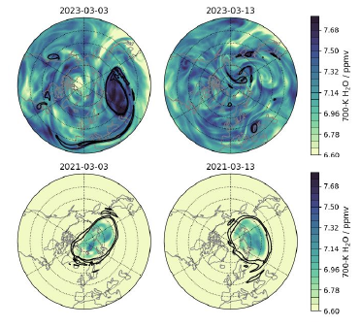
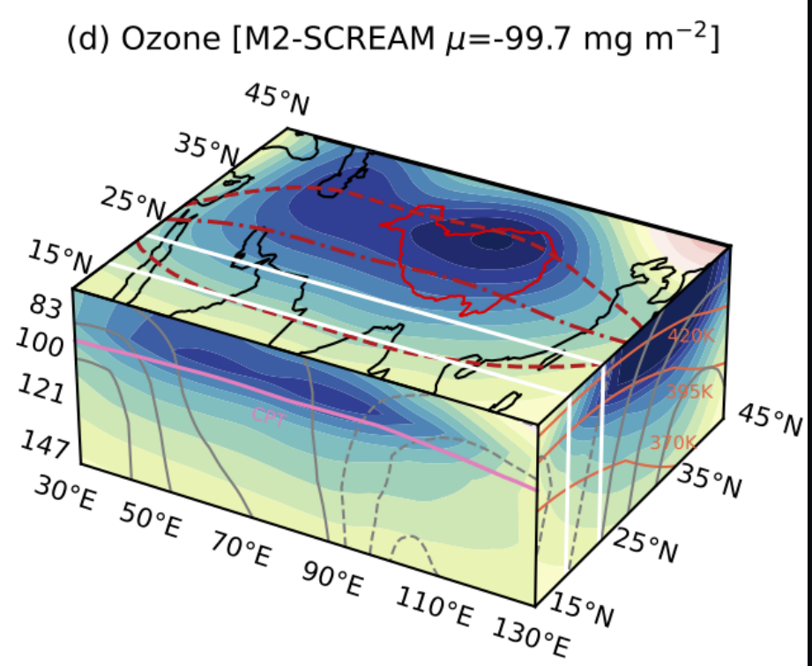
M2-SCREAM: Stratospheric Composition Using Aura MLS
[Asian monsoon "ozone valley" in M2-SCREAM]
Column, good coverage
Near-global, high vertical resolution
Sparse, high vertical resolution
Column, good coverage
Near-global, high vertical resolution
Sparse, high vertical resolution
[M2-SCREAM water vapor before and after HTHH eruption; K. Wargan]
MLS: Microwave Limb Sounder on NASA’s EOS Aura; observations of stratospheric composition profiles
OMI: Ozone Monitoring Instrument on EOS Aura; observations of total column ozone
OMPS: Ozone Monitoring and Profiler Suite on Suomi NPP and NOAA satellites; total and profile ozone
MLS: Microwave Limb Sounder on NASA’s EOS Aura; observations of stratospheric composition profiles
OMI: Ozone Monitoring Instrument on EOS Aura; observations of total column ozone
OMPS: Ozone Monitoring and Profiler Suite on Suomi NPP and NOAA satellites; total and profile ozone
MLS: Microwave Limb Sounder on NASA’s EOS Aura; observations of stratospheric composition profiles
OMI: Ozone Monitoring Instrument on EOS Aura; observations of total column ozone
OMPS: Ozone Monitoring and Profiler Suite on Suomi NPP and NOAA satellites; total and profile ozone

Slide 47
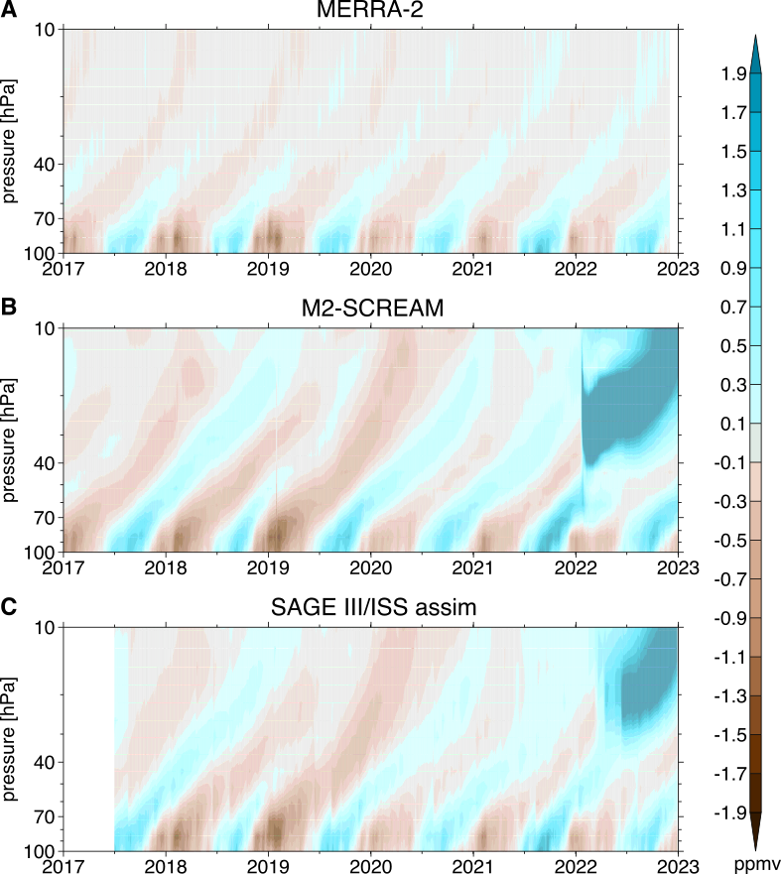
Post-MLS
MLS will be retired next year – can these reanalyses still be useful?
Stratospheric water vapor evolves slowly – just a few high-quality measurements are enough to constrain (see SAGE III at right)
Ozone products are less dependent on Aura MLS, although MLS is useful for profiles
Other constituents are more difficult – many questions unanswered!

Slide 48
GEOS Composition Reanalysis
Stratospheric composition
(M2-SCREAM legacy)
Greenhouse gas data assimilation (OCO-2 L3 legacy)
“All-atmosphere” composition reanalysis under development
GEOS-Chem chemistry model
Meteorology replayed to a recent GMAO’s reanalysis product (GEOS-IT)
Assimilation of stratospheric, tropospheric and GHG data
Production to start later in 2024
Assimilated species: O₃, HCl, HNO₃, N₂O, H₂O, CH₃Cl, CO, NO₂, SO₂, CO₂, CH₄
Aerosol assimilation (AOD) coupled to chemistry and radiation
GEOS Composition Reanalysis
Tropospheric composition
(GEOS-CFv2 legacy)
[Slide courtesy of K. Wargan]

Slide 49
[Slide courtesy of K. Miyazaki]
TCR: Tropospheric Composition Reanalysis
Multi-model
data assimilation
(EnKF x 4 CTMs)
Miyazaki et al., 2020a
Multi-model
integration
Multi-constituent
satellite data
(NO2, O3, CO, HNO3)
GEOS-Chem
Integrated reanalyses
Concentrations & Emissions
AGCM-CHASER
Aura
Aqua
Terra
MIROC-Chem
Reanalysis uncertainty
Chemistry & Transport
MIROC-Chem-H
1. Emissions + σE
2. Concentrations + σC
3. Health Impacts + σH
Multi-mOdel Multi-cOnstituent CHEMical data assimilation (MOMO-Chem)
Notes:
So, the chemical reanalysis framework provides important information on global air pollutant and its attributions. However, systemic model errors must be quantified in order to assess their fidelity. So, we used a multi-model chemical data assimilation framework MOMO-Chem to evaluate the impact of model errors on tropospheric chemistry analysis and health impact assessment. In this framework, we implemented the common data assimilation framework into four CTMs and assimilated the same multi-constituent satellite data. Then, we integrated multi-model reanalyses fields to provide information, that are less dependent on performance of individual models, and its uncertainty due to model errors in model chemistry and transport, which provided possible uncertainty ranges in top-down NOx emissions due to model errors by 13-31%. So this system adds uncertainty information to emission and concentrations and them propagate them to for instance health impact assessment.

Slide 50
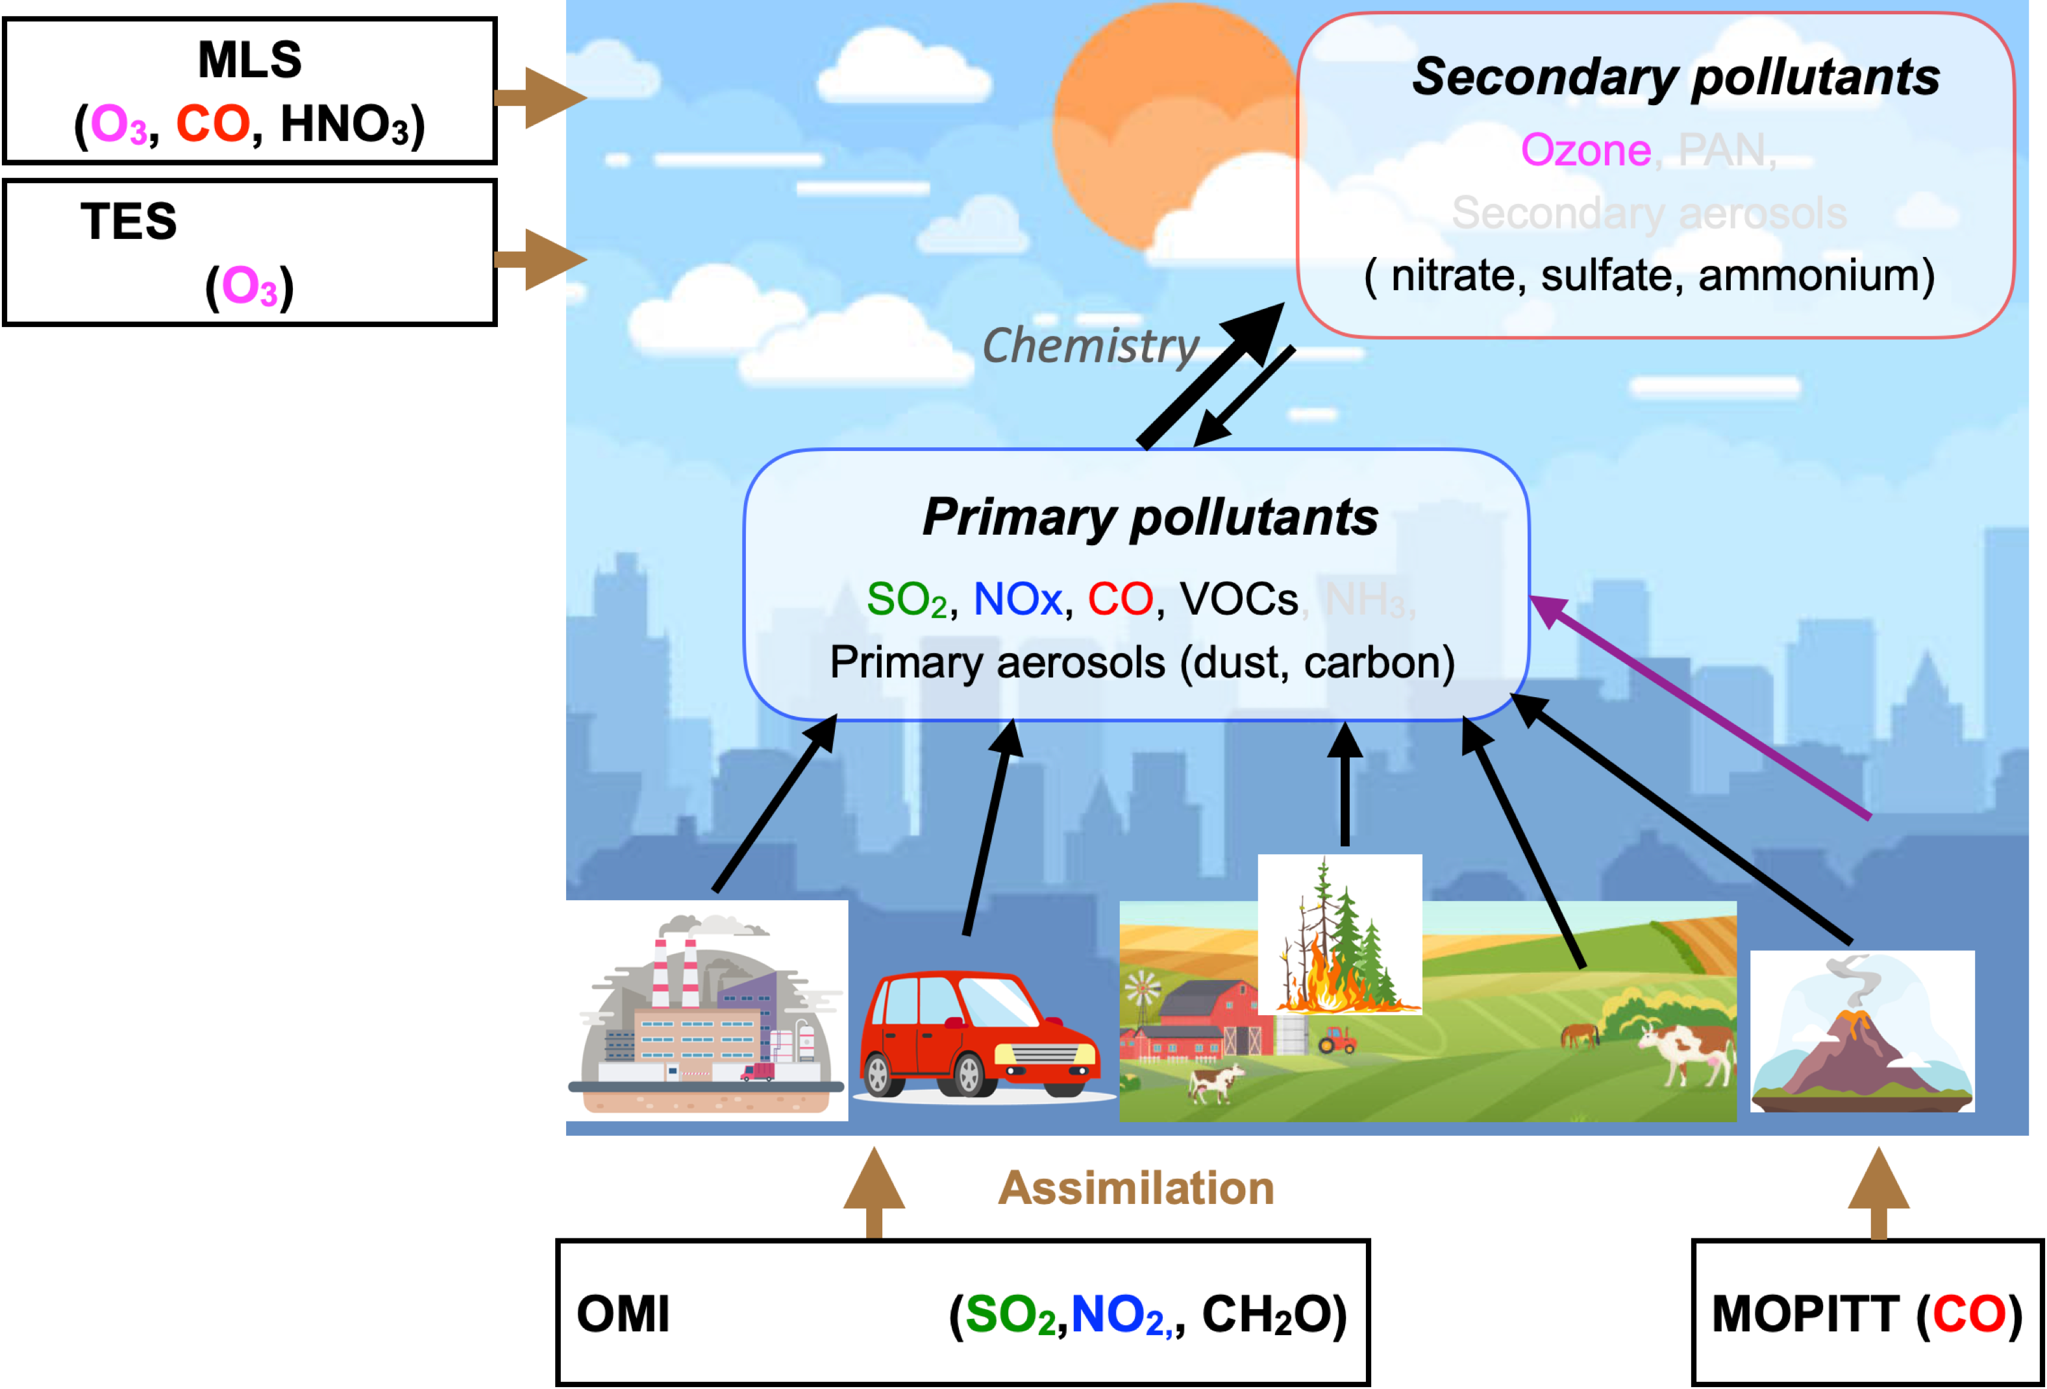
TCR-2
Miyazaki et al. 2020a
Improve estimates of emissions because of reduced model errors unrelated to emissions.
“Decadal Aura era”
chemical reanalysis
[Slide courtesy of K. Miyazaki]
Notes:
This slide shows how data assimilation constrains the tropospheric chemistry system during the Decadal Aura satellite era in our tropospheric chemistry reanalysis version 2, TCR-2. Individual assimilated data provide information on different aspects of the tropospheric chemistry system. The simultaneous optimization of emissions and concentrations of many species is an effective way to provide improved estimates of emissions because of reduced model errors. TCR-2 data has been used in many attribution studies. Most other products analyzes concentration fields only and cannot be used for detailed attribution studies.

Slide 51
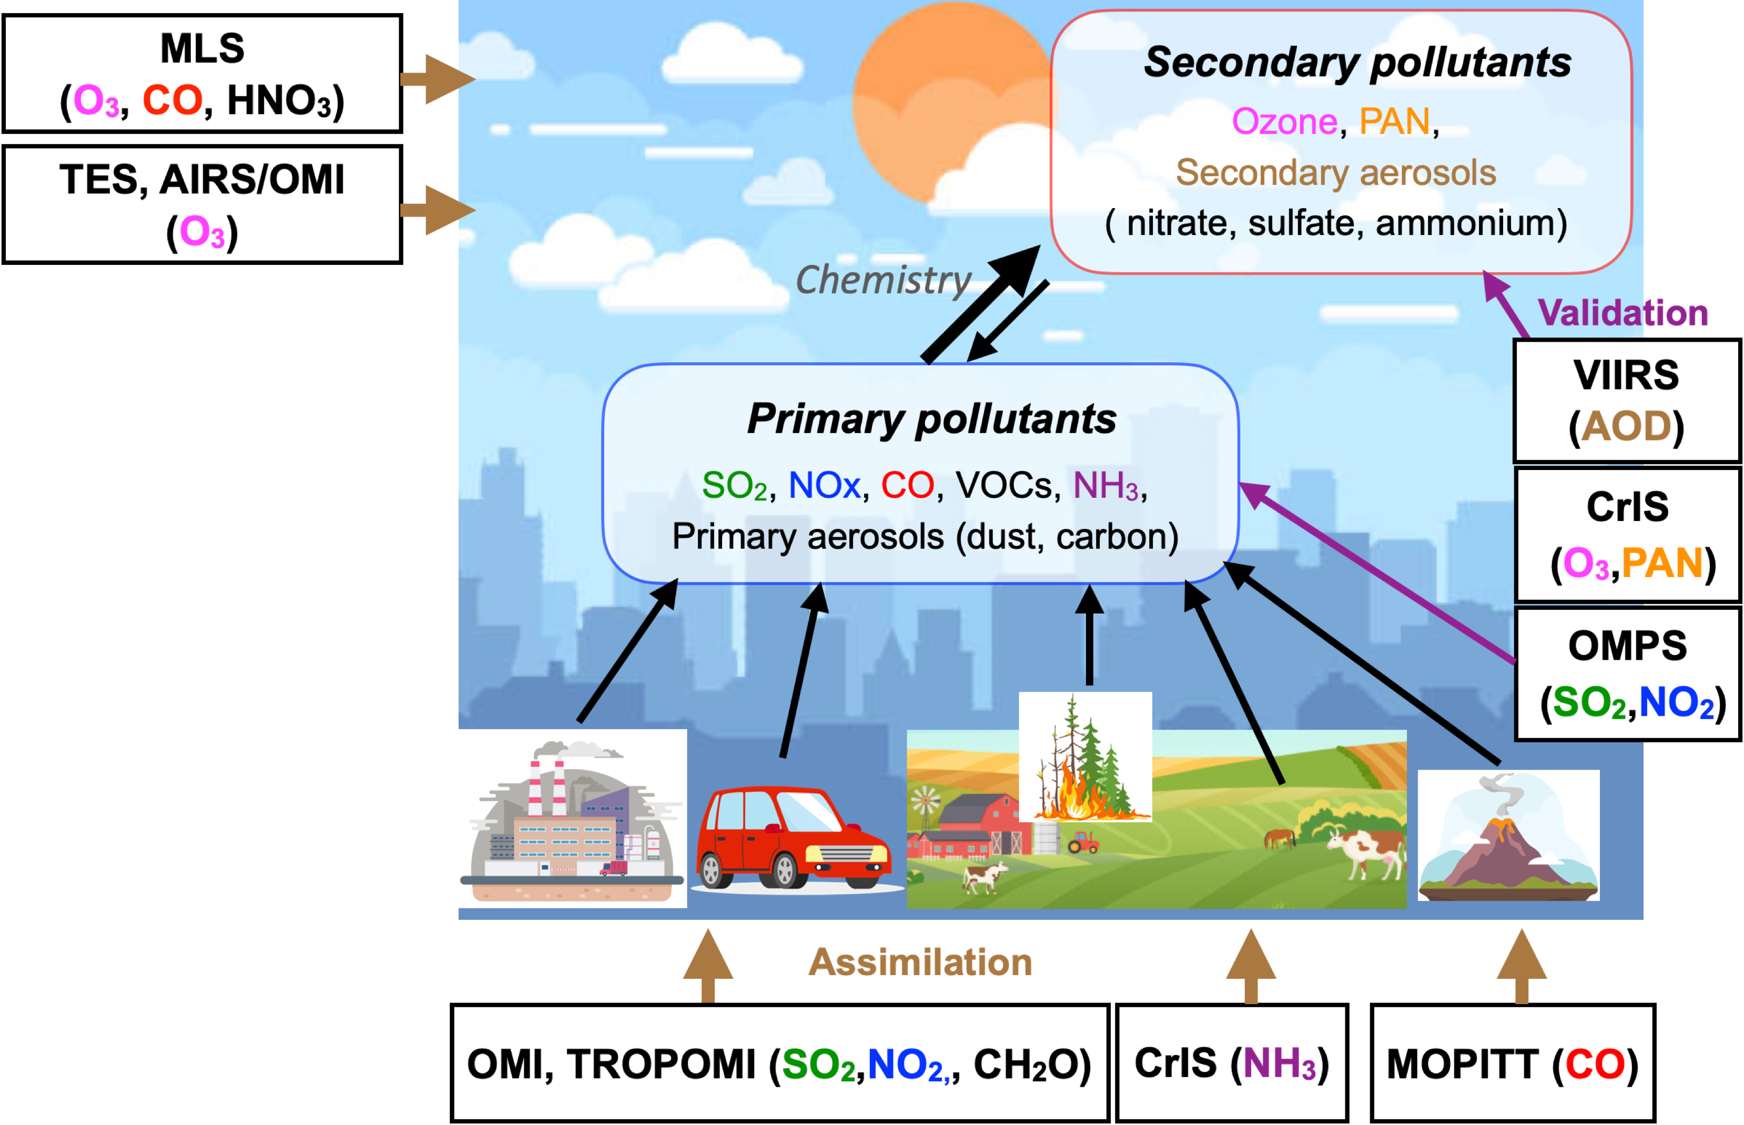
TCR-3
Miyazaki et al.,
In prep.
Long-lived GHGs
Oxidation capacity (OH)
↓
CH4
AQ-GHG co-emissions
↓
CO2
“Decadal Aura +
New satellite era”
chemical reanalysis
[Slide courtesy of K. Miyazaki]
Notes:
This slide shows how data assimilation constrains the tropospheric chemistry system in our latest tropospheric chemistry reanalysis product, TCR-3, which is currently under production. Individual assimilated data provide information on different aspects of the tropospheric chemistry system, including anthropogenic and biogeinc emission sources and stratospheric concentrations. This framework has been used to evaluate changes in various atmospheric composition and to characterize processes that form primary and secondary pollutants from the surface to the lower stratosphere. Emission data generated by this MOMO-Chem data assimilation provide important information to evaluate bottom-up inventories and also unique insight into the air pollutant attributions.
** The chemical reanalysis can also benefit GHG sciences through analysis of OH and co-emission sources, for example, to provide a better representation of the chemical lifetime of greenhouse gases by providing OH constrained by various observations, and to provide information on fossil fuel CO2 emission sources by analyzing co-emission sources.
So, MOMO-Chem takes the full advantage of the AC satellite constellation

Slide 52


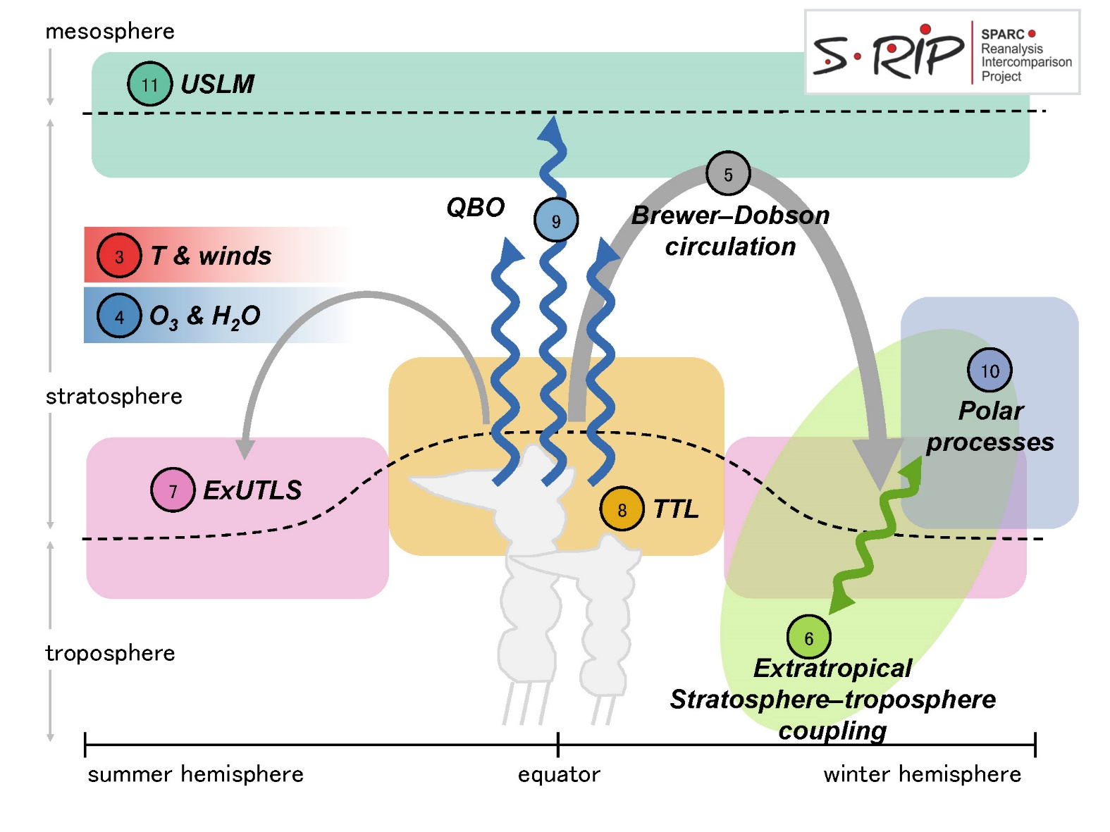
S-RIP Final Report
[report website]

Slide 53
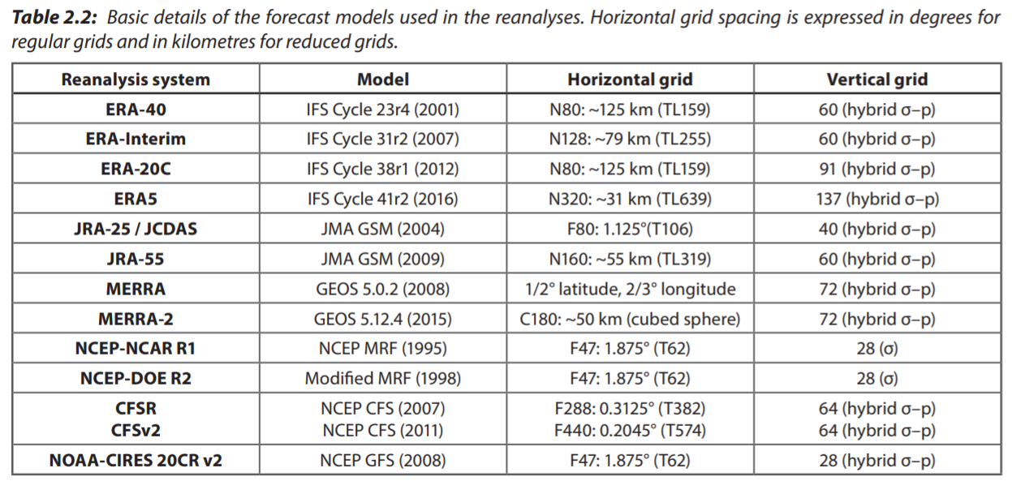
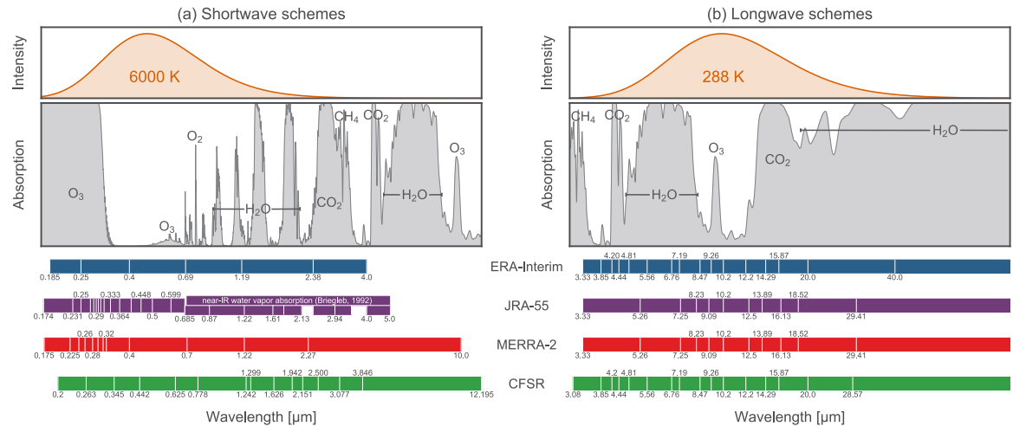
Resources: S-RIP Chapter 2
An introduction for new users and a reference for experienced users:
Chapter 2 should be helpful for anyone using reanalysis products!
Information on key components of 12 global atmospheric reanalysis systems is summarized, including:
the forecast models and their major components
assimilation schemes
observational data
execution streams
archived data products
Now working on an online repository for this information for increased flexibility as new reanalyses are released.

Slide 54


Resources: Special Issues
ACTIVE:
53 PAPERS:

Slide 55


Thank you!
S-RIP Website
Final Report
Comments, questions, suggestions to:
Jonathon S. Wright: jswright@tsinghua.edu.cn

